Slide 1
Health of the Borough May 2023
Foreword | Intro-duction | The Ealing Context | EDI Action Plan | Health & Wellbeing | Housing | Employ-ment & Poverty | Community Engagement | Adults | Children & Young People | Education | Community Safety | Climate Response | Cost of Living | Community Hubs | Appendix
Navigate by scrolling each slide or clicking on the section buttons at the top of each slide. Sections may contain more than one slide

Slide 2
Foreword
Foreword | Intro-duction | The Ealing Context | EDI Action Plan | Health & Wellbeing | Housing | Employ-ment & Poverty | Community Engagement | Adults | Children & Young People | Education | Community Safety | Climate Response | Cost of Living | Community Hubs | Appendix
The pandemic shone a spotlight on the vital role that Public Health plays within our communities, and threw the barriers faced by marginalised and underrepresented communities when it comes to accessing healthcare into sharp relief. These long-standing inequalities have for too long prevented too many Ealing residents from living lives which are as healthy as possible.
These health inequalities – the shortcomings within the system which prevent certain people and groups from receiving the care they need – existed before the pandemic and will not disappear overnight. As a council, we are committed to being open, transparent and inclusive. That means being honest about the scale of the challenge we face, but also being transparent with our residents about our approach to meet it.
Our health is dependent on the world around us – what we call the ‘building blocks’ of health. Those ‘building blocks’ range from access to a good education, high-quality green spaces, safe and affordable housing, employment, social connections – all of which affect how well and long we live.
To cement these ‘building blocks’ and secure lasting, progressive change, we are directly investing £100m over four years into our residents and communities. And we are inviting partners to do the same, whether that’s the NHS, housing associations, charities, or local businesses and the private sector.
This report is an enabler – it sets out how every part of the council could contribute to reducing health inequality. We will continue to work in close partnership with local organisations and residents, including our new Citizens Tribunal and in particular its health sub-committee, as we learn, invest and cement the foundations of those ‘building blocks’ of health.
We hope we can count on your support as we work to make sure that residents across Ealing’s seven towns have ready access to the care and support they need.
Councillor Peter Mason and Councillor Josh Blacker

Slide 3
Introduction
Foreword | Intro-duction | The Ealing Context | EDI Action Plan | Health & Wellbeing | Housing | Employ-ment & Poverty | Community Engagement | Adults | Children & Young People | Education | Community Safety | Climate Response | Cost of Living | Community Hubs | Appendix
The Health of the Borough report shares the Council’s achievements during 2022/23 in our bid to tackle inequalities. Fighting inequality is a key strategic objective under the Council Plan, and this report demonstrates how multiple Council departments are working to support this objective.
By “inequalities”, we mean the unfair and avoidable differences in factors between different groups of people which contributes to and determines an individual's overall health status. Our aim is to create a borough where we work hard to address inequalities in all its forms, to ensure that no-one is left behind in terms of achieving their potential.
In order to tackle inequalities, we must ensure that everyone has the building blocks for good health and are able to protect themselves from poor health through access to knowledge and tools. The ‘building blocks of health and well-being’ refer to a wide range of aspects of our lives, such as work, homes, access to education, skills and learning, green space and transport, how well socially connected we are, and whether we experience poverty or racism; these are the root causes of health and wellbeing, and ultimately impact how well, and how long we live.
By addressing the differences in these factors, we can help to reduce inequalities among people living in Ealing, improve their health and wellbeing, and move towards a fairer, more equal society where everyone thrives.
This report shares work undertaken across different council departments in partnership with multiple partner organisations and communities, all working hard to tackle inequalities in all its forms. The work shared in this report helps to take forward the Race Equality Commission’s recommendations and also demonstrates how the Council is working to meet some of the objectives and priorities of the Council Plan.

Slide 4
The Ealing Context: Population Overview and Health (1/2)
Foreword | Intro-duction | The Ealing Context | EDI Action Plan | Health & Wellbeing | Housing | Employ-ment & Poverty | Community Engagement | Adults | Children & Young People | Education | Community Safety | Climate Response | Cost of Living | Community Hubs | Appendix
Population Overview and Health | The Wider Determinants

Slide 5
The Ealing Context: Population Overview and Health (2/2)
Foreword | Intro-duction | The Ealing Context | EDI Action Plan | Health & Wellbeing | Housing | Employ-ment & Poverty | Community Engagement | Adults | Children & Young People | Education | Community Safety | Climate Response | Cost of Living | Community Hubs | Appendix
Population Overview and Health | The Wider Determinants

Slide 6
The Ealing Context: The Wider Determinants (1/2)
Foreword | Intro-duction | The Ealing Context | EDI Action Plan | Health & Wellbeing | Housing | Employ-ment & Poverty | Community Engagement | Adults | Children & Young People | Education | Community Safety | Climate Response | Cost of Living | Community Hubs | Appendix
Population Overview and Health | The Wider Determinants

Slide 7
The Ealing Context: The Wider Determinants (2/2)
Foreword | Intro-duction | The Ealing Context | EDI Action Plan | Health & Wellbeing | Housing | Employ-ment & Poverty | Community Engagement | Adults | Children & Young People | Education | Community Safety | Climate Response | Cost of Living | Community Hubs | Appendix
Population Overview and Health | The Wider Determinants

Slide 8
Corporate Equalities, Diversity and Inclusion Action Plan
Foreword | Intro-duction | The Ealing Context | EDI Action Plan | Health & Wellbeing | Housing | Employ-ment & Poverty | Community Engagement | Adults | Children & Young People | Education | Community Safety | Climate Response | Cost of Living | Community Hubs | Appendix
The Council’s Corporate Equalities, Diversity and Inclusion (EDI) Action Plan is a 2 year plan for the Council’s workforce, covering the period 1st April 2023- 31st March 2025 in order to drive forward action to ensure we keep to our ambition of high priority and high ambition. The plan is overarching and sets out the actions, success measures and designated responsible officers. Directorate priorities will continue to be reviewed and reflected in the action plan throughout the life of the plan.
Key themes include:
Data: ensuring we collect and analyse workforce data and use the information to inform decisions
Recruitment/representation: exploring opportunities to maximise applications from diverse applicants
Leadership and development: investigating new content to enable senior leaders to lead and tackle inequality and unfair practices provide development and EDI education to staff at all levels using a mix of approaches
Positive Action: understanding how and when to apply the principle in order to address under representation in senior roles
Staff Equality Groups: enabling the groups to increase their involvement and diverse voices in council business
Benchmarking: assessing Ealing’s processes and practices against the London Council EDI Standard and other councils
Examples of actions that council teams have committed to/delivered include:
Establishing accurate and reliable workforce/establishment data to help identify clear EDI targets and inform decision making
Implementation of the race equality action plan and supporting the Citizen’s Tribunal
Development of an internal and external communications plan to support delivery of objectives
Ensuring appraisals are completed with regular reporting to the management team
Setting meaningful targets and management monitoring arrangements
Writing a directorate EDI plan with a distinct race equality strategy

Slide 9
Health &Wellbeing: This Year’s Achievements 2022/23
Foreword | Intro-duction | The Ealing Context | EDI Action Plan | Health & Wellbeing | Housing | Employ-ment & Poverty | Community Engagement | Adults | Children & Young People | Education | Community Safety | Climate Response | Cost of Living | Community Hubs | Appendix
This Year’s Achievements 2022/23 | Case Studies
Health and Wellbeing Strategy 2023-2028: A 5-year Health and Wellbeing Plan, Together in Ealing, is being developed for Ealing which aims to reduce inequalities experienced by communities, and improve the long-term health and wellbeing of all residents in the borough through work on the building blocks of health and wellbeing¹. The strategy has been informed by engagement with communities and partners over the last year. The strategy will be published mid 2023.
Ealing’s Community Champions Programme: The programme was launched in Autumn 2022. The programme recruits volunteers, living or working in Ealing, who want to help people live healthier lives. The programme allows for the better two way dialogue with community members on what matters to them. The volunteers receive training on a wide range of topics including cost of living support, loan shark awareness, and mental health signposting . The volunteers share accurate information with residents, direct people to relevant support and services, and link with existing community groups and organisations in the borough.
Joint Strategic Needs Assessments (JSNA): JSNAs provide an assessment of the current and future health and social care needs of Ealing residents. This helps to inform planning of local services and policies to tackle inequalities. Mental Health JSNA, Sexual Health JSNA and the Healthy Weight, Healthy Lives JSNA are being developed and these will be published shortly.
The Oral Health Bus: This initiative provided free dental check-ups and fluoride varnish application to 380 children at 7 primary schools across the borough, and parents were encouraged to register children with local dentists. Schools were identified based on health needs and deprivation data. Discussions with the Oral Health Promoter about the levels of engagement with oral health work in different schools were also taken into consideration.
Recovery Interventions Service Ealing’s (RISE) dual diagnosis team: This team aims to reach residents who have found it difficult to engage with drug & alcohol treatment because of compounding issues/needs including neurodevelopmental conditions, learning disabilities, challenging personality disorders, poor physical health, safeguarding/exploitation concerns, and lack of family support. The team is peripatetic conducting assessments and reviews through assertive in-reach. The in-reach service is provided at the Mental Health Integrated Network Team where residents can see a Dual Diagnosis Team worker with a Care Co-Ordinator over multiple sessions. A bespoke RISE treatment plan is devised with joint client, MINT, RISE and carer input, and regular reviews.
Sexual and Reproductive Health (SRH) Service: The integrated SRH health service at Mattock Lane was launched in 2022. London Northwest Healthcare Trust (LNWHT) provides a one-stop shop integrated sexual health service from the Mattock Lane site, with access to a range of contraception, testing and treatment of Sexually Transmitted Infections and PrEP a drug which can prevent HIV) and prevention. LNWH in partnership with Voluntary Sector Partners (Spectra, THT and Brook) provide outreach awareness and testing in variety of settings, with a focus on reducing health inequalities, working with groups who may be more vulnerable and less likely to access mainstream services.
¹The ‘building blocks of health and well-being’ refer to a wide range of aspects of our lives, such as work, homes, access to education, skills and learning, green space and transport, how well socially connected we are, and whether we experience poverty or racism; these are the root causes of health and wellbeing, and ultimately impact how well, and how long we live.

Slide 10
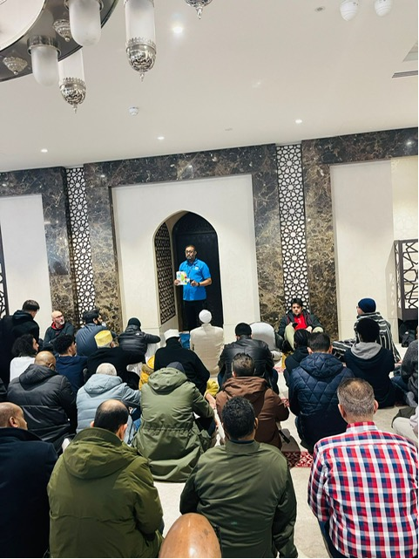
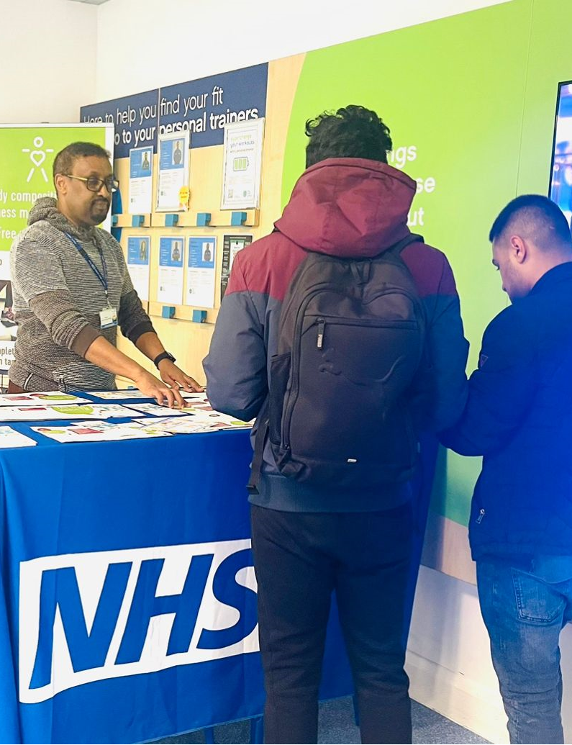
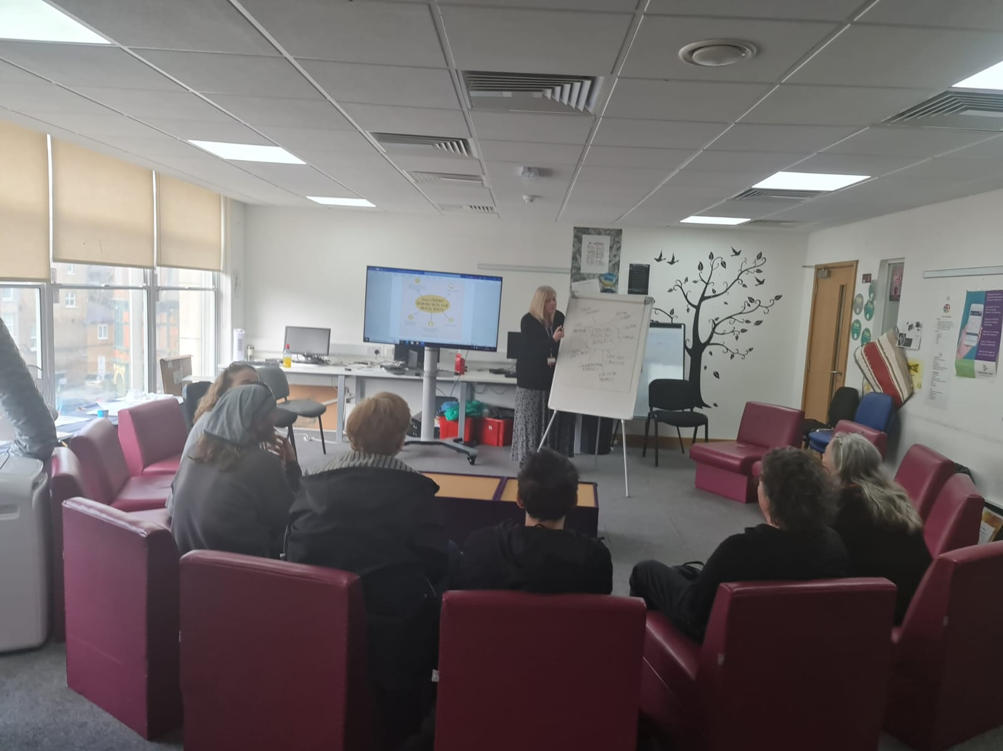
Health & Wellbeing: Case Studies
Foreword | Intro-duction | The Ealing Context | EDI Action Plan | Health & Wellbeing | Housing | Employ-ment & Poverty | Community Engagement | Adults | Children & Young People | Education | Community Safety | Climate Response | Cost of Living | Community Hubs | Appendix
This Year’s Achievements 2022/23 | Case Studies
Case Study: TB Awareness Service
Ealing Council currently commissions West London NHS Trust to provide TB awareness services across Ealing. This service provides awareness raising for residents through in-person events, online events, stalls, and social media especially targeting those who do not engage in health services and to help tackle health inequalities. Community outreach takes place in various settings such libraries, faith settings, businesses, education areas, and NHS venues. The service also provides both in-person and online training for professionals who work with Ealing residents, so they can raise awareness and signpost residents to health services.
Case Study: Substance Misuse Service
The drug and alcohol treatment system (RISE) are running 2 pilots during 2023 in South Southall & Northolt, placing community engagement workers in primary care to deliver alcohol and drug interventions through sessions in GP surgeries, and other community settings including local gurdwaras. The worker will develop strong links with all relevant local services and community groups across the patch to support effective engagement and sustainment in structured treatment. They will be working as part of the neighbourhood network teams aimed at integrating services in multi-disciplinary teams.
They will be providing drug and alcohol treatment to residents with several healthcare needs and integrating the drug and alcohol work into a wider healthcare plan to help residents achieve more sustainable and effective outcomes.
RISE will reach a more hidden group of drinkers and drug users and engage them in treatment at an earlier stage and while they still have recovery capital in place such as friends, family and a job. This means there is the potential to achieve positive outcomes over a shorter treatment journey. The work will be part of several interventions aimed at reducing alcohol related hospital admissions in some of Ealing’s most affected areas.

Slide 11
Housing: This Year’s Achievements 2022/23
Foreword | Intro-duction | The Ealing Context | EDI Action Plan | Health & Wellbeing | Housing | Employ-ment & Poverty | Community Engagement | Adults | Children & Young People | Education | Community Safety | Climate Response | Cost of Living | Community Hubs | Appendix
This Year’s Achievements 2022/23 | Case Studies
The Housing & Homelessness Strategy: The Housing and Homelessness strategy is currently in development. The strategy has a theme focused on tackling housing inequalities such as overcrowding, fair access to the housing register, supporting residents with the cost of living crisis and meeting specialist housing & support needs. Preventing homelessness and rough sleeping is another important theme of this strategy.
The Council extended and expanded its private rented property licensing schemes and established one of the largest property licensing areas in West London which commenced in January 2023 and will bring over two thirds of the private rented sector in to the property licensing framework, the objectives of which include improving housing conditions and property management standards
A number of initiatives were undertaken to help residents avoid becoming, or remaining homeless, including:
Negotiating with landlords or householders to see if homelessness can be prevented or delayed
Considering financial help to tenants, in cases where this would help to persuade landlords to extend a tenancy
Referrals to employment support, to help people overcome welfare benefit caps
Working with colleagues in the property regulation service, in cases of serious disrepair
Referring cases to Safer Renting, for tenancy relations advice, when landlords are acting unlawfully
Helping and supporting households to find new accommodation, when there is no prospect of them remaining in the current home
Assessing whether we can offer financial help with rent deposits; referring customers to the Local Welfare Assistance Team, where this is the appropriate way to get help with tenancy costs
Helping families to move out of London, including to social housing in less pressured, more affordable areas, if that is something they would like to consider
Determining what kind of temporary and longer term housing is suitable, including on health grounds
Referring appropriate customers for supported housing and sheltered housing, or for floating support
Referring customers to Adult or Children’s Social care, for additional support
Working with a DV specialist housing worker to ensure complex domestic abuse situations get the best support and advice
Commissioning a rough sleeping outreach service, provided currently by St Mungo’s
Using grant funding we successfully bid for to house and support rough sleepers, including referrals to specialist drug and alcohol support
Working with rough sleepers who have no recourse to public funds, to link those who could gain settled status or who want to reconnect to a home country, with immigration advice
Working closely with charitable organisations, who can provide additional help and support to those in need

Slide 12
Housing: This Year’s Achievements 2022/23
Foreword | Intro-duction | The Ealing Context | EDI Action Plan | Health & Wellbeing | Housing | Employ-ment & Poverty | Community Engagement | Adults | Children & Young People | Education | Community Safety | Climate Response | Cost of Living | Community Hubs | Appendix
This Year’s Achievements 2022/23 | Case Studies
Case Study: Rough Sleeper
Mr M was a rough sleeper from Poland who did not have settled immigration status in the UK, having failed to apply under the EUSS by the deadline. At the time the rough sleeping outreach services encountered him sleeping rough, in Spring 2022, he had had a cancer diagnosis. The Outreach team asked for the Council to book Mr M into emergency accommodation, so that his circumstances could be fully assessed. A successful bid for funding through the government’s Rough Sleeping Initiative enabled the Council to provide accommodation to Mr M, on a short-term basis, while his immigration status and other needs were assessed. Whilst placed in short-term accommodation, Mr M was supported by our commissioned St Mungo’s team, to gather evidence prove he had been in the UK for 5 years. He was then referred for specialist immigration advice. A Care Act referral was also made. The immigration adviser worked directly with the Home Office and Mr M was granted settled status. A floating support officer was then able to assist Mr M to find a rented studio, in the borough. Once he was housed, a care package was provided. This cross-team, multi-disciplinary working ensured Mr M had a settled base and appropriate care and support, which meant he could engage with cancer treatment from a settled accommodation base.
Case Study: The H Family
The H family were homeless as a result of their tenancy ending and Mr H, the father of 2 children, had had a mental health diagnosis of depression and anxiety. They lost their original tenancy through rent arrears, after Mr H lost his job, because his mental health had led to high sickness absence. Unfortunately, the family then accrued rent arrears in their temporary accommodation and there was a risk of them being evicted again. Efforts to offer budgeting and financial advice to the family led to an arrears reduction plan being put in place but after the family failed to stick to the plan, they were, unfortunately, evicted again. Taking account of Mr H’s health needs and the children’s wellbeing, one further emergency placement was agreed. Mr H’s mental ill health had had a health impact on the rest of his family too. Support was put in around the family, including employment support, Mrs H got work, and, at the same time, Mr H started an online tutoring business. They were able to bring their arrears down to near zero. They were supported in bidding for accommodation and were extremely lucky in being able to access a secure social housing tenancy, outside our borough, but still in Greater London.

Slide 13
Employment & Poverty: This Year’s Achievements 2022/23
Foreword | Intro-duction | The Ealing Context | EDI Action Plan | Health & Wellbeing | Housing | Employ-ment & Poverty | Community Engagement | Adults | Children & Young People | Education | Community Safety | Climate Response | Cost of Living | Community Hubs | Appendix
This Year’s Achievements 2022/23 | Case Studies
A range of bespoke services, for ages 16+, have been commissioned across the borough to ensure a wider reach and tackle inequalities in employment:
BEAM: BEAM provides support for finding suitable housing and employment for Ealing residents who are at risk of homelessness or homeless.
Action West London (AWL): AWL have been commissioned to work with Black men to tackle unemployment. AWL offers training and support with job applications and CVs.
Horizons Pathways programme: This programme has created a diverse range of over 30 placements within the council for care leavers.
Apprenticeships: Ealing Council has its own internal apprenticeship scheme for residents to apply for opportunities within the Council. We are on track to achieve 15 apprenticeships in 22/23.
Free training courses, for adults aged 19+, are delivered across the borough including:
Digital skills: We offer digital skills training to support residents across Ealing to overcome digital disadvantage, build independence and get into employment.
Launched 2 Learning zones: These zones support and empower local digital engagement (available in Northolt and Southall libraries).
Supporting residents into jobs through bespoke English for Speakers of Other Languages (ESOL), English, Maths, Digital, Employability and Professional training to clients and partners including JCP, A2 Dominion, Centre for Armenian Information and advice (Acton) and Ingeus.
Start-up School for Seniors: We have partnered with Start-up School for Seniors to provide support and start-up training to residents over 50 years of age, enabling them to become self-employed.
Integration and wellbeing support: This offer includes ESOL, confidence building, manage finances (Ealing soup kitchen); Chair Yoga, ESOL and health, Tai Chi (Resident involvement team- Acton); First aid for women, Yoga, Yoga Shapes, Koch’s snowflake (learning about fractals and applied this to create a snowflake decoration - Southall community alliance); ESOL courses within settings across Ealing with creche support for parents to support equality and access.

Slide 14
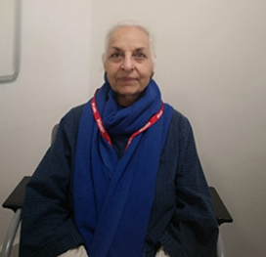
Employment & Poverty: Case Studies
Foreword | Intro-duction | The Ealing Context | EDI Action Plan | Health & Wellbeing | Housing | Employ-ment & Poverty | Community Engagement | Adults | Children & Young People | Education | Community Safety | Climate Response | Cost of Living | Community Hubs | Appendix
This Year’s Achievements 2022/23 | Case Studies
Case Study: Learning Support Assistant in a primary school
Navjot Kaur lives in Southall and completed a Level 1 Childcare course with Learn Ealing. She progressed to our level 2 Supporting Teaching and Learning courses and was then able to secure a full time role as a learning support assistant in a primary school. This is what she had to say:
“This is to say thank you to my most supporting teacher who always guided, encouraged and motivated me to learn and gain practical knowledge and skills. Because of your positive encouragement and guidance, today I am able to secure myself financially by working through agency as a Supply Teaching Assistant. Now, it’s been a month I am working on paid position as Supply TA . This brings a lot of positive change in my life. My family is proud and I feel more valued in my family. Thank you so much for giving direction to my career.”
Case Study: Supporting learners over 50 to re-enter the labour market
Harbinder, 71, an Ealing resident, has a business of freshly prepared chilli relishes, Bavi’s Condiments. Harbinder says: “When I joined the Startup School for Seniors, I was quite surprised. Both Suzanne and Mark were very friendly. They made everyone at ease. The group was nice, they were like me - new people. When I started my business in May, I needed answers to my questions - where to go for information; who to contact; budgeting; how to market your product; why would people want to buy it? And you can Google as much as you'd like but the specific information was difficult to combine. And that’s why this course is very, very, very helpful. Starts ups like these are invaluable.”
According to Suzanne Noble, 60, co-founder of Startup School for Seniors, “many people over 50 have complex lives such as caring for an elderly parent or a child, which prevent them from accessing traditional courses taught in venues. With this in mind, it was important for us to create a course that fits in with our people’s lifestyle and where they could meet others in similar circumstances.”
Mark Elliott, 57, co-founder of the school also adds “many people later in life find it difficult to obtain a job that suits the pace or flexibility that they need, so self-employment or starting a business is often the best way for them to achieve this. Startup School for Seniors shows them what to do and helps them do it.”

Slide 15
Community Engagement: This Year’s Achievements 2022/23
Foreword | Intro-duction | The Ealing Context | EDI Action Plan | Health & Wellbeing | Housing | Employ-ment & Poverty | Community Engagement | Adults | Children & Young People | Education | Community Safety | Climate Response | Cost of Living | Community Hubs | Appendix
This Year’s Achievements 2022/23 | Case Studies
Race Equality Commission (REC) report: A partnership action plan was developed which responds to the demands of the REC report.
Citizen Tribunal: Following on from the REC, an independent body called the “Citizen Tribunal” has been appointed which has the skills and lived experience to hold the Council and its partners to account.
Community Support Matrix project: We have delivered the Community Support Matrix project to develop individuals/groups trusted by people that historically do not trust statutory organisations. The aim of the project was to create pockets of time for the groups that are already working in their local communities to increase their capacity to do what they do best – listening, signposting, caring and developing their volunteers and ensuring there is appropriate training, including enabling engagement with covid vaccination and other public health programmes.
Do Something Good website: We are developing the Do Something Good website hosting the Community Support Directory listing Warm Spaces and support offered by the VCFSE (voluntary, community, faith and social enterprise) sector.
Customer Relationship Management (CRM) system: We are piloting a CRM system using data from the Community Support Directory to deliver targeted and co-ordinated interventions by enabling better liaison across council services.
Multifaiths’ Forum: We are establishing a boroughwide Multifaiths’ Forum, which is being developed with faith leaders and which builds on the work undertaken to engage with the community during the pandemic.
The Ealing Together Fund, crowdfunding opportunity: Since covid this programme, consisting of a dedicated crowdfunding platform and support, has resulted in nine community-led projects. Projects have included helping people with their mental health through English writing, Punjabi theatre, pandemic art, film and outdoor activities, the setting up of a nationally recognised golf academy for children from BAME communities, improving physical access to a local croquet club, and enabling a youth-led creative media team to develop a peer-to-peer mentorship program that provides creative volunteering and job opportunities for young people aged between 16-25 from black, Asian, and minority communities in Ealing.

Slide 16
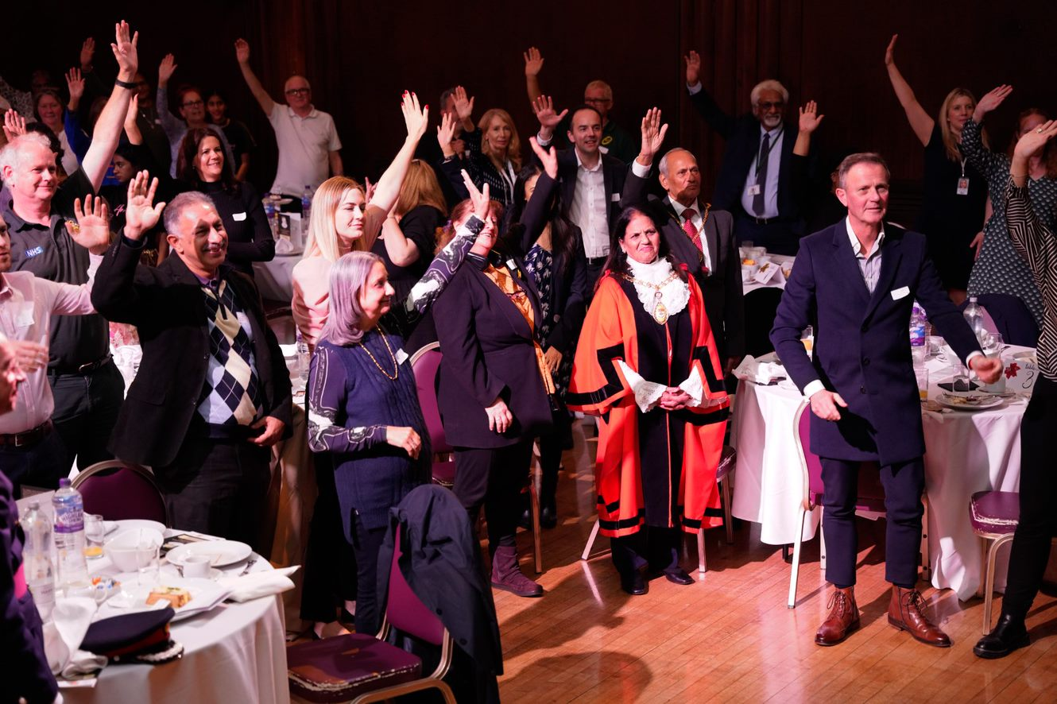
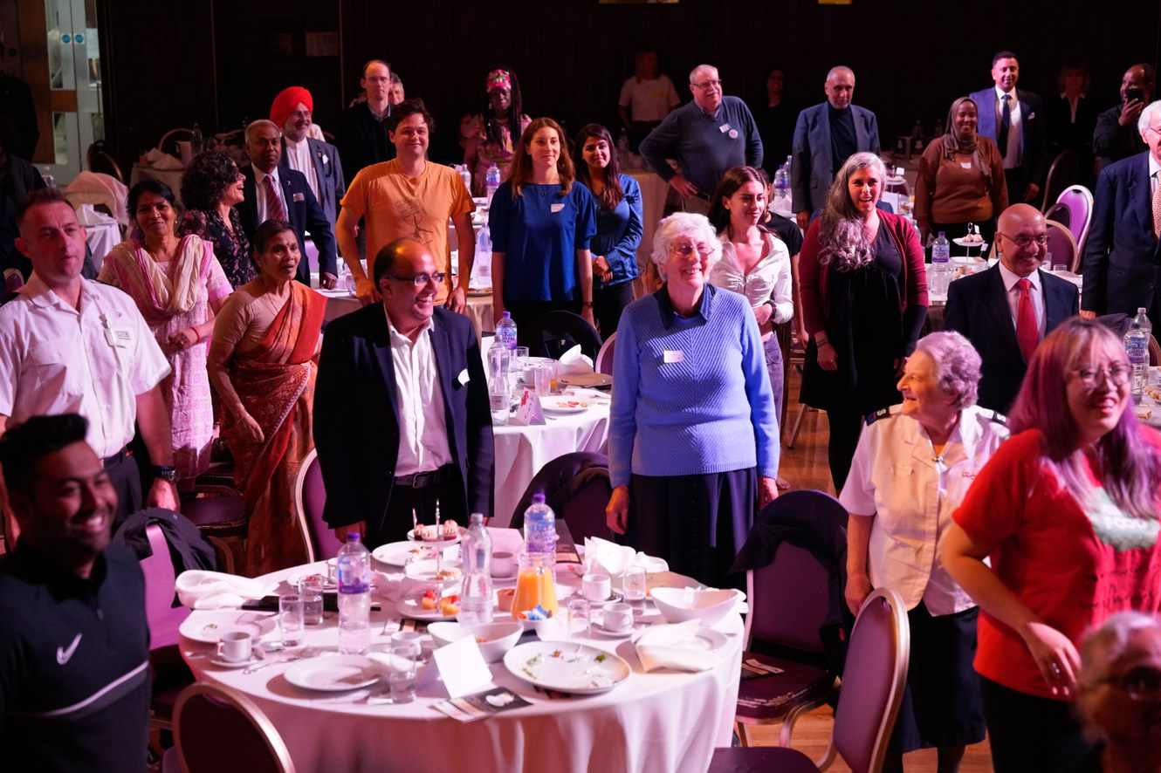
Community Engagement: Case Studies
Foreword | Intro-duction | The Ealing Context | EDI Action Plan | Health & Wellbeing | Housing | Employ-ment & Poverty | Community Engagement | Adults | Children & Young People | Education | Community Safety | Climate Response | Cost of Living | Community Hubs | Appendix
This Year’s Achievements 2022/23 | Case Studies
Case Study: Ealing Together Honours Afternoon Tea
During the pandemic neighbours, community organisations, voluntary services and faith organisations came together to support each other, with food support and shopping, befriending and signposting, provision of PPE and fundraising, and lifting people’s spirits. The public were invited to nominate people and organisations as part of the Ealing Together Honours in 2021 and all those receiving nominations and some of the VCFSE who were active in Ealing Together, came to a celebratory afternoon tea in Greenford Hall in October 2022 with local talent being showcased.

Slide 17
Adults: This Year’s Achievements 2022/23
Foreword | Intro-duction | The Ealing Context | EDI Action Plan | Health & Wellbeing | Housing | Employ-ment & Poverty | Community Engagement | Adults | Children & Young People | Education | Community Safety | Climate Response | Cost of Living | Community Hubs | Appendix
This Year’s Achievements 2022/23
Adult social care supports over 3,000 people to live independently in the community with support. During 2022/23, a range of resident and stakeholder engagement events were undertaken with a view to refining our understanding of local needs, user and carer experience, post COVID, to help us better shape the delivery of services. This includes a consultation and co-design on the following:
Learning Disabilities strategy
The effectiveness of our Partnership Boards
Our Direct Payments offer
Our priorities for people with Autism
Payment of the Real Living Wage as a contract requirement for domiciliary care agencies has also been implemented. An estimated 1,900+ care workers have benefited from the pay uplift to £11.05 per hour which also supports ambitions for local employment and equalities given the profile of what is a predominantly female workforce.
Last year, based on our national user survey, the proportion of people who use social care services who said that those services have made them feel safe and secure rose by over 6% to 86.2%, which is above the London average of 82.1%

Slide 18
Children & Young People: This Year’s Achievements 2022/23
Foreword | Intro-duction | The Ealing Context | EDI Action Plan | Health & Wellbeing | Housing | Employ-ment & Poverty | Community Engagement | Adults | Children & Young People | Education | Community Safety | Climate Response | Cost of Living | Community Hubs | Appendix
Ealing’s Additional & Special Educational Needs and Disabilities (SEND) strategy , co-produced with parent/carers, children, young people & partners will go live in April 2023.
Ealing Early Start service provides integrated health visiting, children’s centres & speech & language services, in partnership with midwifery and perinatal mental health services.
The Youth Plan for Ealing (2022-26) gives a vision and structure upon which Ealing Council, young people, partners, and communities can join to provide programmes and activities. These programmes and activities ensure that every child and young person can be inspired to fulfil their potential in a safe and supported environment across Ealing and that address issues around inequalities and disproportionality. Key strands of work includes enhancing support to young people with SEND and supporting young people and families at risk or victims of gang activity and involvement in the criminal justice system.
Co-production of Ealing Start for Life/Family Hubs, a system-wide model of high-quality, joined up family support services, integrated across health, social care, education, voluntary/community sectors.
The Holiday and Food (HAF) Programme, provides enriching activities & nutritious food, supporting children in receipt of free school meals & targeted vulnerable children, including SEND, throughout main school holidays.
Case Study: Holiday & Food Programme (HAF)
The 2022 Summer HAF programme ran between 1st and 26th August 2022, and 2,629 unique HAF funded children/young people attended. There were 46 providers across 74 venues. 43% (32) based on school sites. In total 22,590 meals were served , 70% in partnership with Akshaya Patra Foundation. In addition, the Felix Foundation delivered 4,202kg of surplus food to HAF settings to distribute to families. This is the equivalent of an additional 10,005 meals. We increased the proportion of secondary school participants to 16% and increased the percentage of children with SEND attending to 28%.

Slide 19
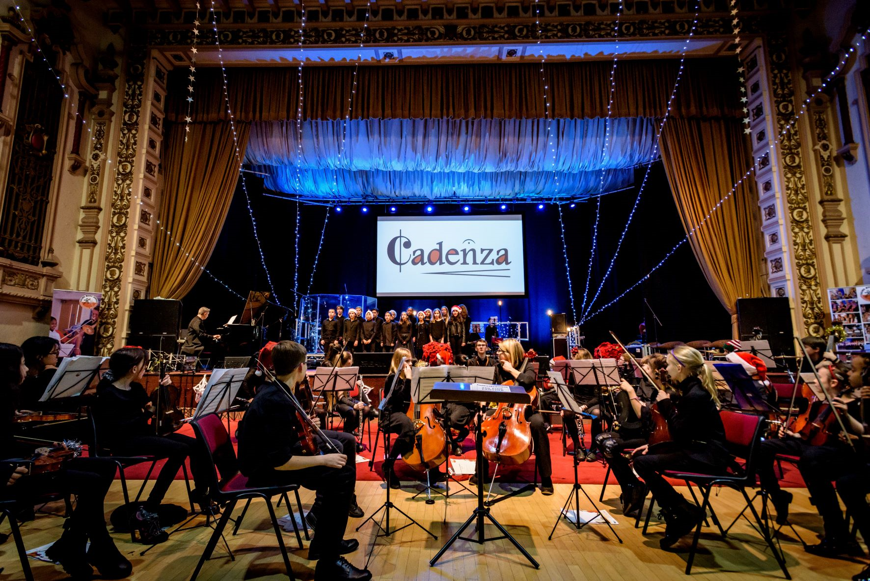
Education: This Year’s Achievements 2022/23
Foreword | Intro-duction | The Ealing Context | EDI Action Plan | Health & Wellbeing | Housing | Employ-ment & Poverty | Community Engagement | Adults | Children & Young People | Education | Community Safety | Climate Response | Cost of Living | Community Hubs | Appendix
Education Race Equality Strategic Plan 2022-2026: An outline of all pledges and planned activity with schools was developed to reduce persistent inequalities in educational outcomes for Black heritage pupils in response to the key findings of the Race Equality Commission.
Ealing Learning Partnership 2023 -2026: An outline of the vision, aims and key ambitions of the council’s partnership with schools to promote educational excellence and wellbeing for all pupils – No learner left behind.
Ealing Learning Partnership delivery plans 2022-2023: Delivery plans co-constructed with schools to achieve ELP’s key mission -no learner left behind; no school left behind. There are five plans targeted at building the capacity of schools to tackle inequalities across full spectrum of disadvantage: Learning and achievement action plan; Safeguarding and wellbeing action plan; SEND and inclusion committee action plan; Progression and pathways action plan; and Recruitment and retention action plan.
Localised and specific programmes and projects delivered by our Schools Partnership and Enrichment Team
Children’s University programme that provides access to extra-curricular activities for pupils from 6 schools in the Northolt / Greenford area of the borough, selected due to the high level of disadvantage in the area
Five schools supported to secure funding from the John Lyon’s charity to subsidise new Parent Ambassador roles in school
SEN Family School Partnership Award that supports schools to review and enhance their engagement with parents of children with additional needs
New training programmes developed for parents of children with additional needs, aiming to empower them to advocate on behalf of their children and also to provide peer-to-peer support. A series of nine information videos produced for parents of children with additional needs around topics such as understanding autism, starting school, speech and language support etc and translated into community languages
Case Study: Ealing Music Service
The Ealing Music Service offers short term music and opera projects specifically to children with additional and special educational needs in partnership with Live Music Now and Orchestra of the Age of Enlightenment at highly reduced rates. Saturday Music Centre offers 50% subsidy to families whose pupils are in receipt of free school meals or pupil premium. Whole Class Ensemble Tuition programmes are offered to all primary schools at highly reduced rates to increase direct participation of pupils.

Slide 20
Community Safety: This Year’s Achievements 2022/23
Foreword | Intro-duction | The Ealing Context | EDI Action Plan | Health & Wellbeing | Housing | Employ-ment & Poverty | Community Engagement | Adults | Children & Young People | Education | Community Safety | Climate Response | Cost of Living | Community Hubs | Appendix
Led a conversation around the challenges of disproportionality with policing including stop and search, engagement with young people, the over representation of black young men in the criminal justice system. This work includes monitoring and holding police to account and undertaking engagement.
Community networks are being created and engagement around extremism and radicalisation, including working with community groups and religious establishments to enable conversations and working with and funding community outreach projects to build capacity.
Working to protect the boroughs most vulnerable residents from criminal, sexual or physical exploitation through interventions like civil or criminal enforcement powers.
A new Male Violence Against Women and Girls strategy has been developed, which includes a borough wide listening exercise to get women’s view on their safety in public, funding new initiatives to make women safer and creating an ongoing dialogue with communities around tackling violence and misogyny.
Case Study: Safer Ealing for Women
Safer Ealing for women was our largest engagement exercise to put women at the heart of our response to making our borough safer for them. Over 3000 women and girls took part, sharing their thoughts and experiences of living in Ealing. Some of the commitments to tackle inequalities, challenge misogyny and make Ealing a fair and inclusive place includes: Installing 14 new HD CCTV cameras in key locations Increasing street lighting on all residential roads Launch a one stop shop website dedicated to VAWG which provides information on reporting, link to StreetSafe app and providing access to support Launch a £40k education program that will be offered to every secondary school, looking at healthy relationships and giving young people the tools to identify and challenge unacceptable behaviours

Slide 21
Climate Response: This Year’s Achievements 2022/23
Foreword | Intro-duction | The Ealing Context | EDI Action Plan | Health & Wellbeing | Housing | Employ-ment & Poverty | Community Engagement | Adults | Children & Young People | Education | Community Safety | Climate Response | Cost of Living | Community Hubs | Appendix
This Year’s Achievements 2022/23 | Case Studies
Healthy Homes Ealing (HHE): HHE is a flagship affordable warmth and fuel poverty reduction programme, which has more than doubled the number of households reached in 2022/23 and will be expanded even further in 2023. HHE connects low-income and vulnerable residents with Energy Efficiency specialists, to help assess their homes and energy use, ensure they are on the best tariff, help with small draughtproofing measures, and refer the household on to other efficiency programmes or agencies which can further assist them.
Breaking Ground: Grant funding has been awarded from Hubbub and the Mayor of London to work with minoritized communities in Northolt to address climate justice. The project, called Breaking Ground, is community-driven and aims to empower residents to develop creative and tangible solutions to issues that are most affecting them, whilst improving health, wellbeing, and the local environment. Delivered in partnership with Building Bridges, the project has been designed to provide kick-start funding to support initial engagement and events over the next year to support the step-by-step process of achieving community-led environmental and social change at a local level.
Low carbon heating system: Grant funded installation of low carbon heating system and renewable power is being delivered at four sheltered homes to tackle carbon emissions and protect residents against rising energy costs. These projects will pilot innovative, renewable and affordable heat, will deliver improved local air quality and will support local community in understanding the required transition to low-carbon economy.

Slide 22
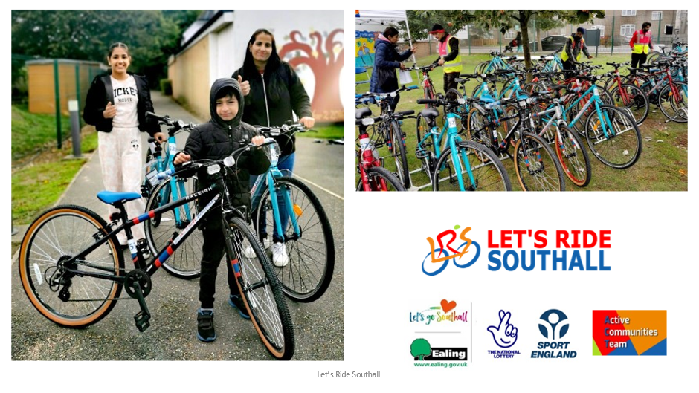
Climate Response: Case Studies
Foreword | Intro-duction | The Ealing Context | EDI Action Plan | Health & Wellbeing | Housing | Employ-ment & Poverty | Community Engagement | Adults | Children & Young People | Education | Community Safety | Climate Response | Cost of Living | Community Hubs | Appendix
This Year’s Achievements 2022/23 | Case Studies
Case Study: Green Homes Grant programme
Ealing has led the Department for Business, Energy and Industrial Strategy funded Green Homes Grant programme for a coalition of West London boroughs since early 2021, carrying out energy efficiency retrofits on over 500 homes. This programme offers grants, averaging around £10,000 per home, to low-income and vulnerable residents living in cold homes (measured by their energy performance certificate rating). The programme, which aims to reduce fuel poverty and to create good paying jobs across West London, is still delivering works across 13 boroughs.
Case Study: Let’s Ride Southall
The Let’s Ride Southall (LRS) programme is the largest community cycle project in London, using relationship power through a social movement to help remove the multiple barriers certain communities face in terms positive behaviour change. Up to 2,500 cycles will be provided for free with all accessories and training. The project plans to overcome key barriers such as having a good roadworthy bike, friends to cycle with, language and cultural support with training in nearby locations.
The programme develops local residents to become mechanics, instructors and cycle leads to create a future platform.
The Let’s Ride Southall programme is making strides in developing local partnerships and is in the driving seat for making an impact towards the council’s ambition to tackle the climate emergency. We have a key partnership with West London Waste Authority (WLWA) that allows us to get ‘free’ second hand bikes to refurbish and distribute back into the community as part our overall sustainability model with c200 bicycles received that would otherwise have gone into landfill. LRS mechanics work with WLWA to triage bikes pool and support delivery of a key recycling partnership. Locally development of skills and employment is being used in the wider system to support sustainable and health outcomes.
Recently, Let’s Ride Southall headlined at the Local Government Association’s national COP27 event as an example of how the system can create climate action change with the numerous health benefits that are attached - air quality improvement via reduced traffic, regular exercise as part of daily lifestyle integration – as well as the social benefits of community cycling for all by the inclusion of 35 bespoke adapted tri-cycles.

Slide 23
Cost of Living: This Year’s Achievements 2022/23
Foreword | Intro-duction | The Ealing Context | EDI Action Plan | Health & Wellbeing | Housing | Employ-ment & Poverty | Community Engagement | Adults | Children & Young People | Education | Community Safety | Climate Response | Cost of Living | Community Hubs | Appendix
Tackling digital exclusion by:
Providing laptops to unemployed and/or low income residents who are digitally excluded.
Registering our Community Hubs to become data banks which will enable residents to access free data for phones and other devices.
Training ‘Community Champions’ to also become ‘Digital Champions’ to support those who lack confidence and skills to use digital devices / transact online.
Allocating funding to voluntary sector organisations to purchase devices and hardware to enable them to better support their digitally excluded clients
Signposting: Information is provided regarding financial, and other, support that is available to residents and how they can access it. The contact centre also carries out proactive calls targeted at low income residents to ensure they are aware of the cost of living support available and to signpost to relevant services.
Warm spaces: Grant funding is being provided to local organisations to support the development and ongoing provision of 25 warm spaces in the borough (funded up to end of March 2023). These warm spaces are heated, welcoming, safe spaces in local voluntary, community and faith organisations buildings across the borough. Residents are welcome to spend as long as they want in comfort at the warm spaces, free of charge. Many of the facilities also offered tea, coffee and biscuits and have other events on simultaneously.
Pension Credit Uptake Campaign: This campaign specifically targets those who are entitled to receive, but have not applied for, pension credit.
Offering physical space to a local resident who has been collecting community donations for residents in need.
Supporting the development of a food partnership specifically looking to fill a gap of emergency food provision in Southall.
Cost of Living Dashboard: a dash board is being developed which will illustrate demand for key services and trends over time.

Slide 24
Community Hubs: This Year’s Achievements 2022/23
Foreword | Intro-duction | The Ealing Context | EDI Action Plan | Health & Wellbeing | Housing | Employ-ment & Poverty | Community Engagement | Adults | Children & Young People | Education | Community Safety | Climate Response | Cost of Living | Community Hubs | Appendix
This Year’s Achievements 2022/23 | Case Studies
There are four Community Hubs set up in 2022/23. These are council customer service centres, distributed across the borough in Acton, Ealing, Northolt and Southall. Community Hubs provide residents with an option to self-serve or to directly speak to a Service Advisor who either help and advise the resident in solving their issue, triages or signposts them into a service or organisation that can better support them.
Residents have been supported to access the energy rebate and household support fund as part of the Council's cost of living response.
Learning Zones were launched from Northolt and Southall Community Hubs offering training and learning opportunities and career support to residents.
The Local Welfare Assistance team delivered advice and support from Hubs, on top of existing commitments in the job centre, foodbanks and Southall food hub.
Council Tax have set up a free training session around identifying someone who may be a victim of a loan shark and how to make referrals to the Illegal Money Lending team.

Slide 25
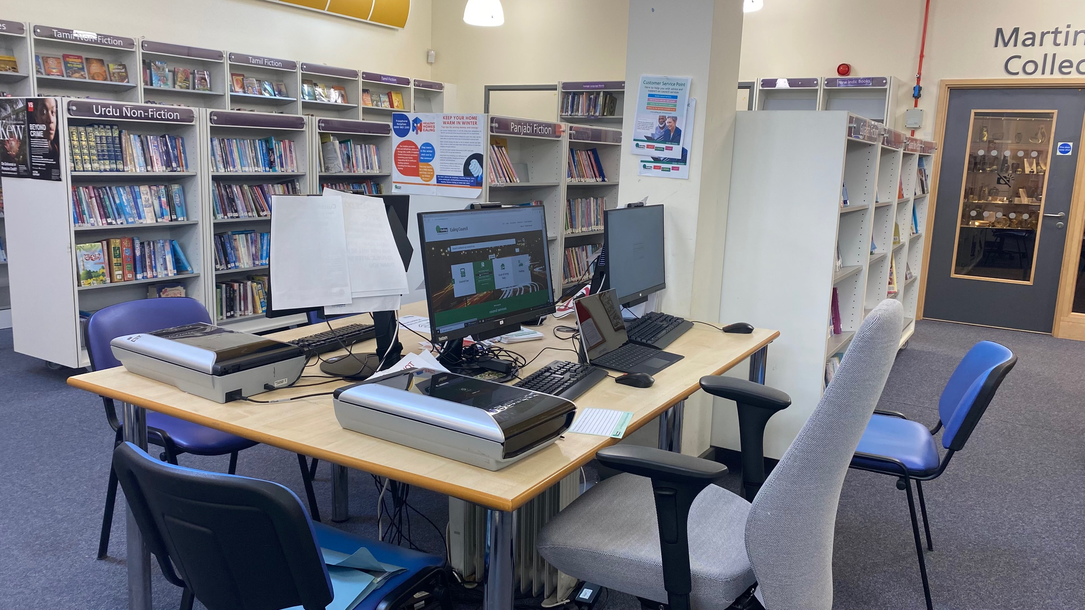
Community Hubs: Case Studies
Foreword | Intro-duction | The Ealing Context | EDI Action Plan | Health & Wellbeing | Housing | Employ-ment & Poverty | Community Engagement | Adults | Children & Young People | Education | Community Safety | Climate Response | Cost of Living | Community Hubs | Appendix
This Year’s Achievements 2022/23 | Case Studies
Case Study: Community Hub Service Advisor shares her experience
Community Hub Service Advisor, Rosa shares her experience:
“After six months in the role, I have lots of similar stories to tell but this was one of my first customers in Southall who truly benefitted from the support we offer.
Unfortunately, a local gentleman and regular library user had been out of work for some time. A medical condition meant he was in constant pain and was unable to work. He knew he needed to apply for Disability Benefits but did not have the internet at home so I supported him with the initial application. During our conversations I found out he was in arrears with his rent payments and he was also struggling to pay for food.
We discussed his options and I immediately referred him to the Southall Foodbank while we worked through the other support he could apply for. I also encouraged him to discuss his rent arrears with the council’s housing department which resulted in an affordable payment plan which was more manageable.
With the immediate pressure relieved, over the next few days he revisited the library and with my support he applied for a Discretionary Housing Payment and a Crisis Payment from Local Welfare Assistance. He had the digital skills to make the applications independently with a little support from me to scan the right documents. Both applications were successful and enabled him to get back on track with his finances.
Looking for other ways he could save money, I suggested he contacted his mobile phone provider to see if they had a social tariff to support customers on low incomes. It turned out they did which really made a difference to his monthly budget.
As he is a regular library user, I’ve seen him many times since and he’s like a different person, no longer with the weight of the world on his shoulders. Every time he thanks me for the support I offered him. It makes my job so rewarding to know I have supported someone to turn things around for themselves.”

Slide 26
Appendix – data sources
Foreword | Intro-duction | The Ealing Context | EDI Action Plan | Health & Wellbeing | Housing | Employ-ment & Poverty | Community Engagement | Adults | Children & Young People | Education | Community Safety | Climate Response | Cost of Living | Community Hubs | Appendix
Population
National Census, 2021
Ethnicity: National Census, 2021
Top community languages : National Census, 2021
Deprivation
ONS, 2019
Life expectancy
ONS, PHE Local Health Profile, 2021
Free School Meals
Public Health Outcomes Framework, accessed Feb 2023
Alcohol related hospital admissions
Public Health Outcomes Framework, accessed Feb 2023
Obesity/physical activity/ smoking / TB
Public Health Outcomes Framework, accessed Feb 2023
Diabetes prevalence
Whole Systems Integrated Care Dashboard, 2022
Housing
National Census, 2021
Private rented property licensing schemes – consultation document, Ealing Council 2021
Land Registry
Department for Levelling Up, Housing and Communities - live stats on homelessness
Income & Unemployment
Industrious Ealing 2022
CACI, Equalised PayCheck Directory 2021
Education
Public Health Outcomes Framework, accessed Feb 2023
Ethnic Group Attainment Report, 2022
Crime
Public Health Outcomes Framework , accessed Feb 2023
Air Quality
Ealing Council: Air Quality JSNA 2019

