Slide 1
Ealing Town Profiles
Health and Wellbeing
Annual Public Health Report
May 2023
Foreword | Introduction | Acton | Ealing Town | Greenford | Hanwell | Northolt | Perivale | Southall | Appendices
Navigate by scrolling each slide or clicking on the section buttons at the top of each slide. Sections may contain more than one slide

Slide 2
Foreword
Foreword | Introduction | Acton | Ealing Town | Greenford | Hanwell | Northolt | Perivale | Southall | Appendices
Ealing is made up of seven towns. Each town has its own unique identity and character and each town faces very different opportunities and challenges to one another. The 7 Towns approach forms the basis of Ealing’s Council Plan.
Health and wellbeing is affected by a wide range of factors in our lives. These are called the “building blocks” of health and include employment, housing, access to education, skills and learning, green space and transport, how well socially connected we are, and whether we experience poverty or racism; these are the root causes of health and wellbeing, and they affect how well and how long we live.
This report is a starter in our quest to better understand the health, wellbeing and inequalities in each of the seven towns in Ealing. Being able to better understand data across the range of factors that affect our health and wellbeing, at a town level, provides very useful insights. Our aim is to continue building up this dataset over the coming months and years, enriching our understanding of the unique differences between each town, and building on targeted action to reduce inequalities and improve the health and wellbeing of each of the seven towns.
Anna Bryden
Director of Public Health
Ealing Council

Slide 3
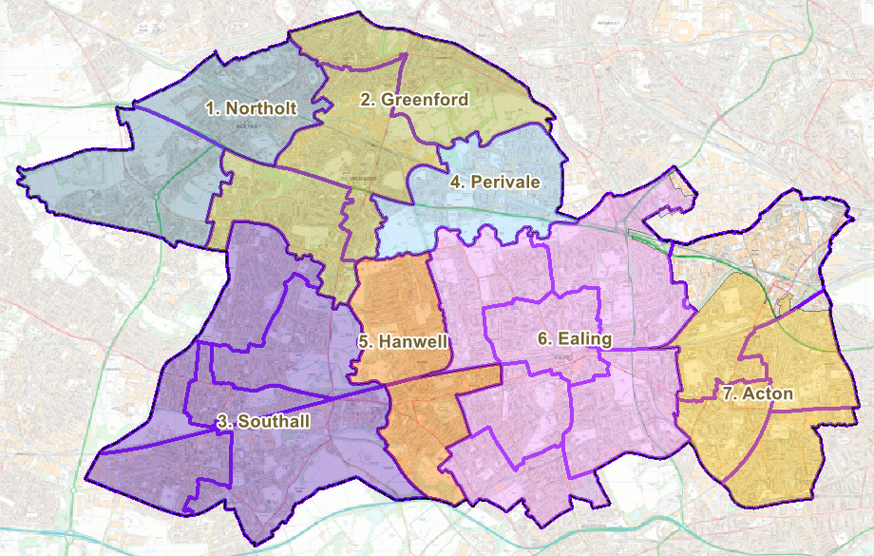
Introduction
Foreword | Introduction | Acton | Ealing Town | Greenford | Hanwell | Northolt | Perivale | Southall | Appendices
Ealing residents live in one of seven towns:
Acton
Ealing Town
Greenford
Hanwell
Northolt
Perivale
Southall
The map shows the boundaries of the 7 towns.
This report provides an initial overview of health and wellbeing for each town. The aim is to build up the town level dataset over the next year. This data will be stored on the Ealing Joint Strategic Needs Assessment (JSNA) section of the Council website. This dataset will include quantitative data alongside case studies and community voice. Everybody, from residents to businesses to the third sector, will be able to access and use this data to better understand the inequalities, health and wellbeing of populations in Ealing at a town level.

Slide 4
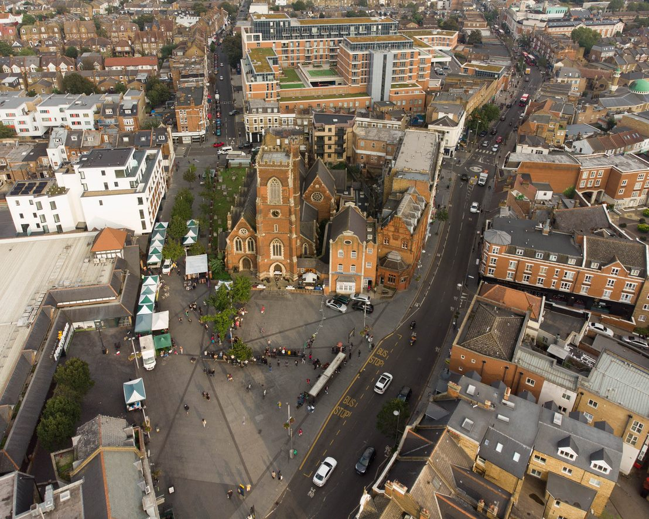
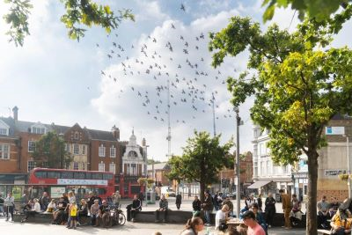
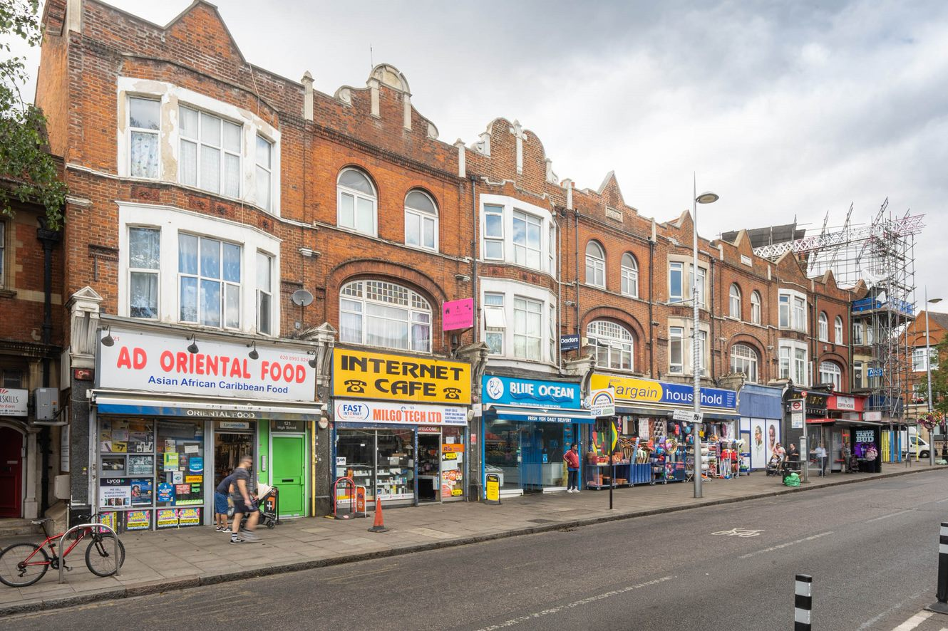
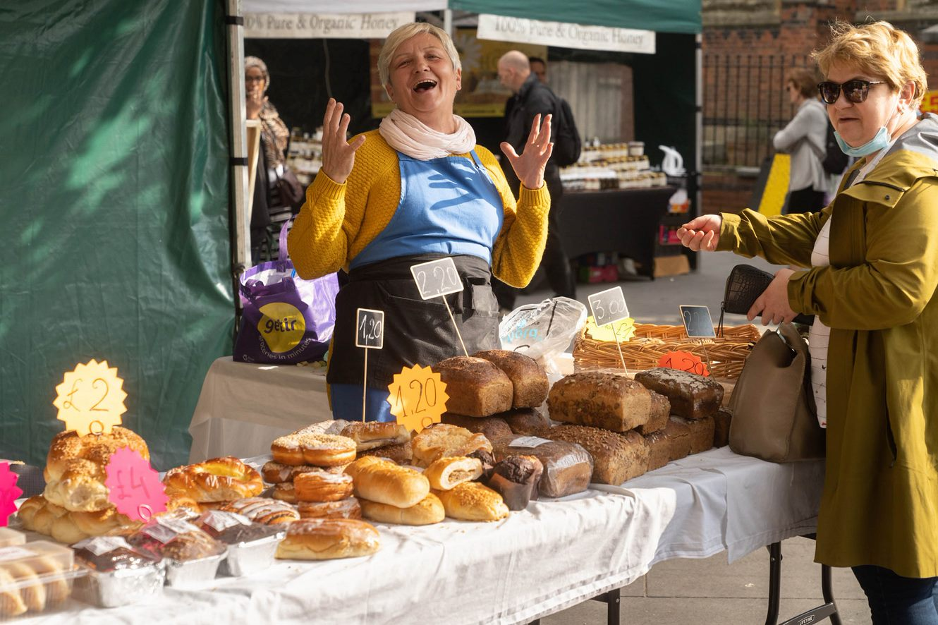
ACTON
Foreword | Introduction | Acton | Ealing Town | Greenford | Hanwell | Northolt | Perivale | Southall | Appendices
Key Statistics | Population Overview | Health Profile | The Wider Determinants | Community Voice

Slide 5
Acton: Key Statistics
Foreword | Introduction | Acton | Ealing Town | Greenford | Hanwell | Northolt | Perivale | Southall | Appendices
Key Statistics | Population Overview | Health Profile | The Wider Determinants | Community Voice

Slide 6
Acton: Population Overview
Foreword | Introduction | Acton | Ealing Town | Greenford | Hanwell | Northolt | Perivale | Southall | Appendices
Key Statistics | Population Overview | Health Profile | The Wider Determinants | Community Voice
Population
There are 67,546 residents living in Acton
Acton wards have the highest density of residents per km2 ( 9201.6 vs 6611.6 usual residents per km2 for the borough)
Residents identifying as White British (31.5%) make up the largest proportion (28%) of the Acton population, followed by White Other (24.6%)
Acton has the highest proportion of residents identifying as Other White across the seven towns. This is followed by the 2nd highest proportion of residents identifying as Mixed ethnicity and 3rd highest proportion of residents identifying as Black/Black British
The largest religious identity in Acton is Christianity (39.9% of the population)
Approximately two thirds of people (16+) in Acton households have English as their main language. This is the 3rd highest proportion across the seven towns
After English, the top two languages spoken by children resident in Acton and attending Ealing state-maintained schools are Arabic followed by Somali
Acton has the second lowest proportion (3.9%) of self-reported bad or very bad health across the borough
Deprivation
Three out of four wards in Acton have an Index of Multiple Deprivation (IMD) Score that is higher than the borough and England average including Acton Central (24.1), East Acton (24.7) and South Acton (29.0). The higher the IMD score, the more deprived the area
5 out of 36 LSOAs* in Acton are in the most deprived 20%. Acton has the 4th highest proportion of the most deprived LSOAs across the seven towns (13.9%)
14.5% of the Acton population live in income-deprived households. This is the 4th highest proportion amongst the 7 towns (Ealing borough: 14.1%, England: 12.9%)
*Lower Layer Super Output Area (LSOA) is a geographic area designed to improve the reporting of small area statistics in England and Wales. LSOAs have an average population of 1500 people or 650 households and there are 196 LSOAs in Ealing.

Slide 7
Acton: Health Profile
Foreword | Introduction | Acton | Ealing Town | Greenford | Hanwell | Northolt | Perivale | Southall | Appendices
Key Statistics | Population Overview | Health Profile | The Wider Determinants | Community Voice
Life expectancy
South Acton ward has the lowest life expectancy of all Acton wards (76.5 years for men; 82.5 years for women). Men living in Southfield live on average 5.8 years longer than men living in South Acton; women living in Southfield live on average 3.7 years longer than women living in South Acton.
Prevalence of long-term conditions in adults 18+*
Second lowest rate of obesity in the borough. The highest rates in Acton are in the White & Black Caribbean population and the Black Caribbean population, both significantly higher than the Acton average
Lowest rate of diabetes in the borough - one in twenty people over the age of 17 are diabetic. In Acton, all ethnic groups, except for White British, White Other and Chinese, have rates of diabetes similar to or significantly higher than the Acton average.
Lowest rate of hypertension in the borough. The Black Caribbean, Mixed White & Black Caribbean and White Irish populations have the highest rates, all significantly higher than the Acton average
Forth highest rate of depression in the borough. In Acton, all ethnic groups, except for White Other and Chinese, have rates of depression similar to or significantly higher than the Acton average.
Other health indicators
Emergency hospital admissions for all causes, all ages, is approximately 12% lower than the England average
Hospital admissions for conditions attributable to alcohol is 5% lower than the England average (England: 100 and Ealing borough: 108.2)
The rates of overweight and obesity in Reception (19.8%) and Year 6 children (35.3%) are lower than the Ealing average (21.1% reception; 39.2% Year 6)
*data relates to number of people diagnosed.

Slide 8
Acton: The Wider Determinants
Foreword | Introduction | Acton | Ealing Town | Greenford | Hanwell | Northolt | Perivale | Southall | Appendices
Key Statistics | Population Overview | Health Profile | The Wider Determinants | Community Voice
Income & Unemployment
Median household income estimates per year range across Acton wards from £33,041 in Acton Central to £48,728 in Southfield (Ealing borough - £34,491; London - £36,427; UK - £32,400)
8.0% of working age population claiming out of work benefit - 2nd lowest proportion amongst the 7 towns
3.3 per 1,000 working age population (age 16-64) are long-term unemployed - 4th lowest rate across the 7 towns
Housing
Second highest number of households (27,475) across the seven towns; of these, 38.3% are owner occupied, 38.1% are privately rented, 20.4% are socially rented, 3.0% are in shared ownership, and 0.2% live rent free
Education
Second highest proportion of children (34.3%) eligible for Free School Meals in the borough
Third highest proportion of children achieving a good level of development at the end of reception, and the third highest proportion of pupils achieving expected standard in Reading Writing Maths at Key Stage 2
Crime
There were 6,045 total notifiable offences (TNO) in Acton in 2022. The TNO rate is higher than the Ealing average
There were 128 domestic abuse offences (DAO) in Acton in 2022. The DAO rate is lower than the Ealing average

Slide 9
Acton: Community Voice
Foreword | Introduction | Acton | Ealing Town | Greenford | Hanwell | Northolt | Perivale | Southall | Appendices
Key Statistics | Population Overview | Health Profile | The Wider Determinants | Community Voice
What matters to Acton residents for their health and wellbeing?
“GP appointments are difficult to get; only phone appointments easier to get now.”
Acton Gardens Centre engagement event
“Safe and affordable places to go with my children and more free activities for children, clubs.”
Acton Gardens Community Centre engagement event
“There should be more access for young people to be able to use fields and pitches for football, netball, tennis.”
Bollo Youth Centre engagement event
“We are happy with our culture – we have our own ways of living/ our culture and our life, we don’t want to change that.”
Community conversations with residents of the gypsy and traveller site
“More youth clubs for young people to have a safe space to go to.”
Bollo Youth Centre engagement event

Slide 10
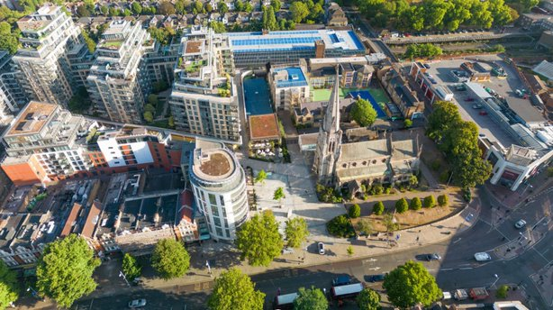
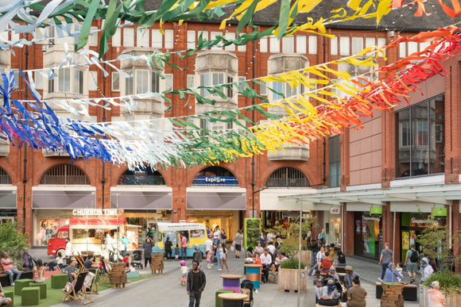
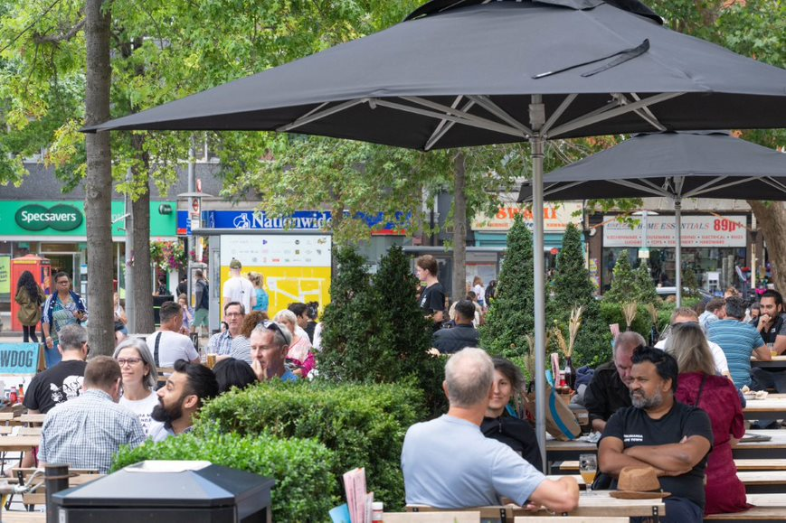
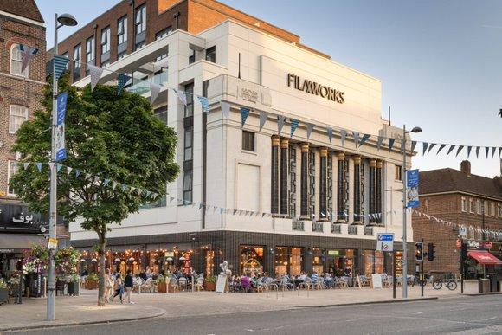
EALING TOWN
Foreword | Introduction | Acton | Ealing Town | Greenford | Hanwell | Northolt | Perivale | Southall | Appendices
Key Statistics | Population Overview | Health Profile | The Wider Determinants | Community Voice

Slide 11
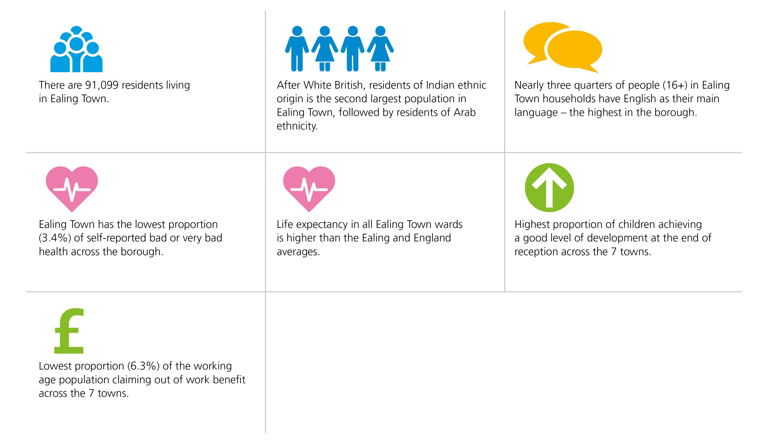
Ealing Town: Key Statistics
Foreword | Introduction | Acton | Ealing Town | Greenford | Hanwell | Northolt | Perivale | Southall | Appendices
Key Statistics | Population Overview | Health Profile | The Wider Determinants | Community Voice

Slide 12
Ealing Town: Population Overview
Foreword | Introduction | Acton | Ealing Town | Greenford | Hanwell | Northolt | Perivale | Southall | Appendices
Key Statistics | Population Overview | Health Profile | The Wider Determinants | Community Voice
Population
There are 91,099 residents living in Ealing Town
Ealing Town has the highest proportion of residents identifying as White British (36.8%), second highest White Other (24.2%) and the lowest proportion of residents identifying as Black or Black British (6.9%) across the seven towns.
The largest religious identity is Christianity (42.4% of the population), followed by Islam (12.6%)
Nearly three quarters of people (16+) in Ealing Town households have English as their main language – the highest in the borough.
After English, the top two languages spoken by children resident in Ealing Town and attending Ealing state-maintained schools are Arabic followed by Polish
Ealing Town has the lowest proportion (3.4%) of self-reported bad or very bad health across the borough
Deprivation
All six wards in Ealing Town have an Index of Multiple Deprivation (IMD) Score that is lower than the borough average
3 out of 51 LSOAs* in Ealing Town are in the most deprived 20%. Ealing Town has the lowest proportion of the most deprived LSOAs across the seven towns (5.9%)
Ealing Town has the lowest proportion (9.7%) of residents living in income-deprived households across the seven towns
*Lower Layer Super Output Area (LSOA) is a geographic area designed to improve the reporting of small area statistics in England and Wales. LSOAs have an average population of 1500 people or 650 households and there are 196 LSOAs in Ealing.

Slide 13
Ealing Town: Health Profile
Foreword | Introduction | Acton | Ealing Town | Greenford | Hanwell | Northolt | Perivale | Southall | Appendices
Key Statistics | Population Overview | Health Profile | The Wider Determinants | Community Voice
Life expectancy and deaths
Life expectancy in all Ealing Town wards is higher than the Ealing and England averages
The rate of preventable deaths is lower than the Ealing and England averages
Second lowest rate of deaths involving COVID-19 across the seven towns
Prevalence of long-term conditions in adults 18+*
Lowest rate of obesity in the borough. The Black Caribbean population, Other Black and Black African populations have the highest rates, all significantly higher than the Ealing town average
Second lowest rate of diabetes in the borough. The Black Caribbean population has the highest rate, followed by the Indian and Pakistani populations, all significantly higher than the Ealing Town average
Second lowest rate of hypertension in the borough. The Black Caribbean population has the highest rate at nearly 2.5 times the Ealing Town average
Third highest rate of depression in the borough. The Mixed White & Black Caribbean, Black Caribbean, White British, Other Mixed and Pakistani populations have the highest rates - all s significantly higher than Ealing Town average
Other health indicators
Emergency hospital admissions for all causes, all ages, is approximately 8.4% lower than the England average
Hospital admissions for conditions attributable to alcohol is 7.3% lower than the England average (England: 100 and Ealing borough: 108.2)
The rates of overweight and obesity in Reception (18%) and Year 6 children (32.3%) are lower than the Ealing average (21.1% reception; 39.2% Year 6)
*data relates to number of people diagnosed.

Slide 14
Ealing Town: The Wider Determinants
Foreword | Introduction | Acton | Ealing Town | Greenford | Hanwell | Northolt | Perivale | Southall | Appendices
Key Statistics | Population Overview | Health Profile | The Wider Determinants | Community Voice
Income & Unemployment
Median household income estimates per year range across Ealing Town wards from £39,048 in Cleveland to £48,012 in Ealing Broadway (Ealing borough - £34,491; London - £36,427; UK - £32,400)
Lowest proportion (6.3%)of the working age population claiming out of work benefit across the 7 towns
2.8 per 1,000 working age population (age 16-64) are long-term unemployed – 2nd lowest rate across the 7 towns
Housing
Highest number of households (37,363) across the seven towns; of these, 49.4% are owner occupied, 37.4% are privately rented, 11.9% are socially rented, 1.2 % are in shared ownership, and 0.1% live rent free
Education
Lowest proportion of children (19.4%) eligible for Free School Meals
Highest proportion of children achieving a good level of development at the end of reception, and the joint highest proportion of pupils achieving expected standard in Reading Writing Maths at Key Stage 2 across the 7 towns
Crime
There were 8,112 total notifiable offences (TNO) in Ealing Town in 2022. The TNO rate is lower than the Ealing average
There were 164 domestic abuse offences (DAO) in Ealing Town in 2022. The DAO rate is lower than the Ealing average

Slide 15
Ealing Town: Community Voice
Foreword | Introduction | Acton | Ealing Town | Greenford | Hanwell | Northolt | Perivale | Southall | Appendices
Key Statistics | Population Overview | Health Profile | The Wider Determinants | Community Voice
What matters to Ealing Town residents for their health and wellbeing?
Themes from the EHCVS Engagement event, West Ealing Library
Need for green space and clean air.
Themes from the EHCVS Engagement event, West Ealing Library
Engaging in passions and hobbies like allotments, and belonging to communities like religious groups.
Themes from the EHCVS Engagement event, West Ealing Library
Connecting with people, having places to meet the people we like and being able to afford doing the things we like.
Themes from the EHCVS Engagement event, West Ealing Library
Focus on green and safe areas as well as adapted and accessible spaces for those with different needs and of different ages.
Themes from the EHCVS Engagement event, West Ealing Library

Slide 16
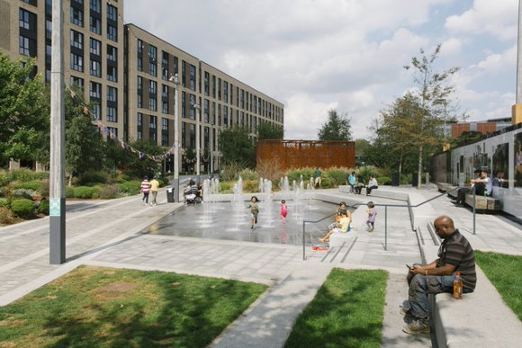
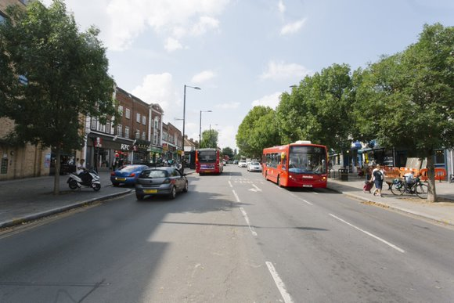
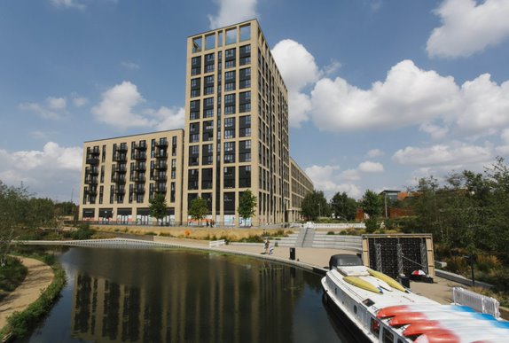
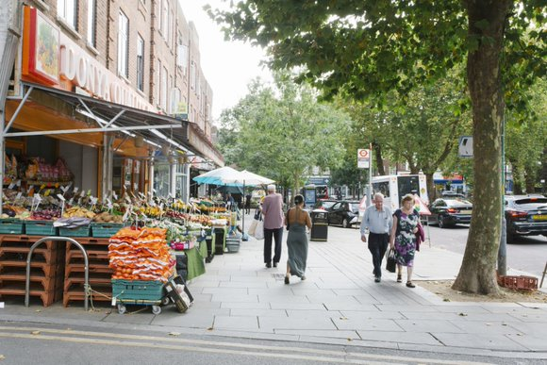
GREENFORD
Foreword | Introduction | Acton | Ealing Town | Greenford | Hanwell | Northolt | Perivale | Southall | Appendices
Key Statistics | Population Overview | Health Profile | The Wider Determinants | Case Studies

Slide 17
Greenford: Key Statistics
Foreword | Introduction | Acton | Ealing Town | Greenford | Hanwell | Northolt | Perivale | Southall | Appendices
Key Statistics | Population Overview | Health Profile | The Wider Determinants | Case Studies

Slide 18
Greenford: Population Overview
Foreword | Introduction | Acton | Ealing Town | Greenford | Hanwell | Northolt | Perivale | Southall | Appendices
Key Statistics | Population Overview | Health Profile | The Wider Determinants | Case Studies
Population
There are 47,296 residents living in Greenford
Greenford has the 2nd highest proportion of residents identifying as Asian/Asian British ethnicity (31.4%) and also the 2nd highest proportion of residents of Black/Black British ethnic origin (12.3%) across the seven towns. 19.1% of residents identify as White British and 21.4% of residents identify as White Other.
The largest religious identity is Christianity (43.2% of the population), followed by Islam (20.1%)
Third lowest proportion of households (58.9%) across the borough with English as their main language
After English, the top two languages spoken by children resident in Greenford and attending Ealing state-maintained schools are Polish followed by Arabic
Greenford has the joint third highest proportion (4.3%) of self-reported bad or very bad health across the borough
Deprivation
Greenford Broadway has an Index of Multiple Deprivation (IMD) Score (27.1) that is higher than the borough average (22.7). The higher the IMD score the more deprived the area. North Greenford and Greenford Green have an IMD score lower than the borough average.
3 out of 26 LSOAs* in Greenford are in the most deprived 20%, Greenford has the 3rd lowest proportion of the most deprived LSOAs across the seven towns (11.5%)
Greenford has the third lowest proportion (13.2%) of residents living in income-deprived households across the seven towns
*Lower Layer Super Output Area (LSOA) is a geographic area designed to improve the reporting of small area statistics in England and Wales. LSOAs have an average population of 1500 people or 650 households and there are 196 LSOAs in Ealing.

Slide 19
Greenford: Health Profile
Foreword | Introduction | Acton | Ealing Town | Greenford | Hanwell | Northolt | Perivale | Southall | Appendices
Key Statistics | Population Overview | Health Profile | The Wider Determinants | Case Studies
Life expectancy and deaths
Greenford Broadway ward has the lowest life expectancy of all Greenford wards (77.6 years for men; 83.2 years for women). Men living in North Greenford live on average 5.2 years longer than men living in Greenford Broadway; women living in North Greenford live on average 2.4 years longer than women living in Greenford Broadway.
The rate of preventable deaths is lower than the Ealing and England averages
Joint third highest rate of deaths involving Covid across the seven towns
Prevalence of long-term conditions in adults 18+*
Second highest rate of obesity in the borough. The highest rates are amongst residents from the Black Caribbean, the White & Black Caribbean, Bangladeshi, Irish and White British populations, significantly higher than the Greenford average
Third highest rate of diabetes in the borough. The Bangladeshi population has the highest rate, significantly higher than the Greenford average
Third highest rate of hypertension in the borough. The Black Caribbean population has the highest rate, significantly higher than the Greenford average
Third lowest rate of depression in the borough. The highest rate is amongst the White British, Mixed White & Black Caribbean, White Irish, Other Mixed and Pakistani populations - all significantly higher than the Greenford average. Note - there are low levels of recorded depression among South Asian communities. This may under-represent the true picture in some groups.
Other health indicators
Emergency hospital admissions for all causes, all ages, is approximately 8% higher than the England average
Hospital admissions for conditions attributable to alcohol is similar to the England average (England: 100 and Ealing borough: 108.2)
The rates of overweight and obesity in Reception (21.5%) and Year 6 children (42.0%) are higher than the Ealing average (21.1% reception; 39.2% Year 6)
*data relates to number of people diagnosed.

Slide 20
Greenford: The Wider Determinants
Foreword | Introduction | Acton | Ealing Town | Greenford | Hanwell | Northolt | Perivale | Southall | Appendices
Key Statistics | Population Overview | Health Profile | The Wider Determinants | Case Studies
Income & Unemployment
Median household income estimates per year range across Greenford wards from £28,657 in Greenford Broadway to £31,812 in Greenford Green (Ealing borough - £34,491; London - £36,427; UK - £32,400)
Third lowest proportion (8.2%)of the working age population claiming out of work benefit across the 7 towns
Lowest rate of long-term unemployed in the working age population (2.5 per 1,000) across the borough
Housing
Fourth highest number of households (16,397) across the seven towns; of these, 51.8% are owner occupied, 29.8% are privately rented, 15.6% are socially rented, 2.5 % are in shared ownership, and 0.2% live rent free
Education
Third lowest proportion of children (25%) eligible for Free School Meals across the seven towns
Third lowest proportion of children achieving a good level of development at the end of reception, and third lowest proportion of pupils achieving expected standard in Reading Writing Maths at Key Stage 2 across the 7 towns
Crime
There were 3,517 total notifiable offences (TNO) in Greenford in 2022. The TNO rate is lower than the Ealing average
There were 109 domestic abuse offences (DAO) in Greenford in 2022. The DAO rate is lower than the Ealing average

Slide 21
Children’s University in Greenford (Enrichment)
Foreword | Introduction | Acton | Ealing Town | Greenford | Hanwell | Northolt | Perivale | Southall | Appendices
Key Statistics | Population Overview | Health Profile | The Wider Determinants | Case Studies
The Children’s University programme has been funded by the John Lyon’s Charity since 2020. It was set up in a partnership between the Council and four schools in recognition of the high levels of disadvantage and the limited availability of enrichment activities in the local area. The Children’s University has benefitted pupils in a number of ways. It has acknowledged and validated extra-curricular activities that they participate in whilst at school and it has provided them with opportunities to experience new activities as a direct result of their school being part of the Children’s University.
An analysis of the activities that children have taken part in shows a wide variety. Sports and physical activities were popular and this is no surprise as clubs are run in school and children can access these at little or no cost. Science, Technology, Engineering and Maths (STEM) was the next most popular category. For example, the CU schools worked with HS2 and their supply chain to meet local people that work for them. Arts, culture and music is a priority for the CU schools. Some worked with the local university who delivered ‘Theatre in Education’ workshops in school, performing assessment pieces as part of their degree courses. They also brought instruments and worked with 180 children. This was particularly popular with pupils as many do not get opportunities to see live performances.
Many families in the area rely on schools to provide enrichment activities for their children as they do not have the finances to access them outside of school. This shows how heavily families rely on school but also shows the constant demand on schools to provide additional opportunities for families in the area. The John Lyon’s grant and the partnership between the Council and schools has enabled the Children’s University to begin to address the inequality of opportunity faced by some children in the area.

Slide 22
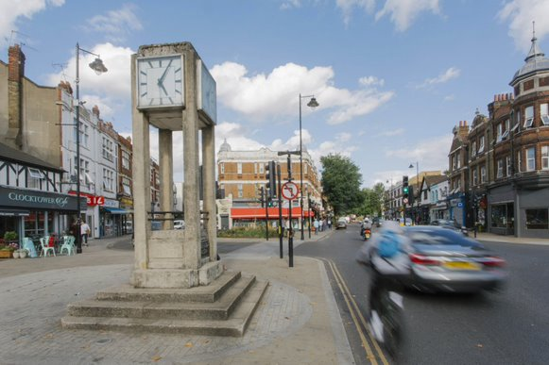
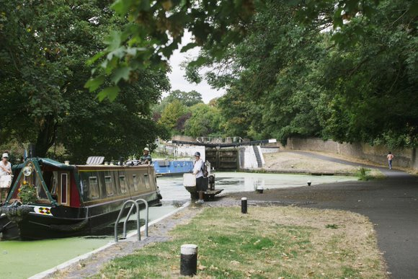
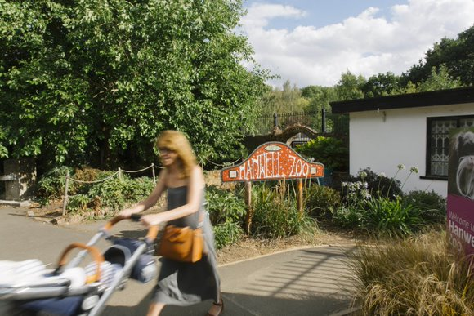
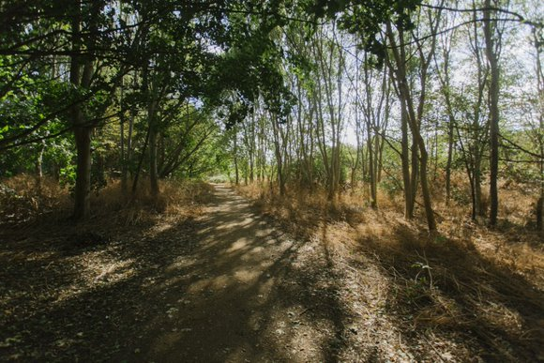
HANWELL
Foreword | Introduction | Acton | Ealing Town | Greenford | Hanwell | Northolt | Perivale | Southall | Appendices
Key Statistics | Population Overview | Health Profile | The Wider Determinants

Slide 23
Hanwell: Key Statistics
Foreword | Introduction | Acton | Ealing Town | Greenford | Hanwell | Northolt | Perivale | Southall | Appendices
Key Statistics | Population Overview | Health Profile | The Wider Determinants

Slide 24
Hanwell: Population Overview
Foreword | Introduction | Acton | Ealing Town | Greenford | Hanwell | Northolt | Perivale | Southall | Appendices
Key Statistics | Population Overview | Health Profile | The Wider Determinants
Population
There are 30,330 residents living in Hanwell
Hanwell has the highest proportion of residents of Mixed ethnicity and the second highest proportion of White British residents across the seven towns
The largest religious identity is Christianity (45.6%), followed by no religion (24.9%)
Second highest proportion of households (69.6%) across the borough with English as their main language
After English, the top two languages spoken by children resident in Hanwell and attending Ealing state-maintained schools are Polish followed by Arabic
Hanwell has the joint third highest proportion (4.3%) of self-reported bad or very bad health across the borough
Deprivation
Hanwell wards have an Index of Multiple Deprivation (IMD) Score (Hobbayne 23.4; Elthorne 24.2) that is higher than the borough average (22.7). The higher the IMD score the more deprived the area.
4 out of 17 LSOAs* in Hanwell are in the most deprived 20%. Hanwell has the 3rd highest proportion of the most deprived LSOAs across the seven towns (23.5%)
Hanwell has the third highest proportion (15.7%) of residents living in income-deprived households across the seven towns
*Lower Layer Super Output Area (LSOA) is a geographic area designed to improve the reporting of small area statistics in England and Wales. LSOAs have an average population of 1500 people or 650 households and there are 196 LSOAs in Ealing.

Slide 25
Hanwell: Health Profile
Foreword | Introduction | Acton | Ealing Town | Greenford | Hanwell | Northolt | Perivale | Southall | Appendices
Key Statistics | Population Overview | Health Profile | The Wider Determinants
Life expectancy and deaths
The life expectancy of men and women living in Elthorne ward (78.6 years for men; 82.2 years for women) is lower than the Ealing average (80.3 years for men; 84.4 years for women). Men living in Hobbayne live on average 3.5 years longer than men living in Elthorne; women living in Hobbayne live on average 3.3 years longer than women living in Elthorne
The rate of preventable deaths is 6.3% higher than the England average
Second highest rate of deaths involving Covid across the seven towns
Prevalence of long-term conditions in adults 18+*
Third lowest rate of obesity in the borough. The highest rates are in the Black Caribbean, Other Black and Pakistani populations – all significantly higher than the Hanwell average
Third lowest rate of diabetes in the borough. The highest rates are in the Indian, Pakistani, Black Caribbean and Other Asian populations, all significantly higher than the Hanwell average
Third lowest rate of hypertension in the borough. The highest rate is amongst residents of Black Caribbean ethnicity, nearly double the Hanwell average
Highest rate of depression in the borough, 1.2 times the Ealing average
Other health indicators
Emergency hospital admissions for all causes, all ages, is approximately 17% higher than the England average
Hospital admissions for conditions attributable to alcohol is 18.6% higher than the England average (England: 100 and Ealing borough: 108.2)
The rates of overweight and obesity in Reception (19.9%) and Year 6 children (34.9%) are lower than the Ealing average (21.1% reception; 39.2% Year 6)
*data relates to number of people diagnosed.

Slide 26
Hanwell: The Wider Determinants
Foreword | Introduction | Acton | Ealing Town | Greenford | Hanwell | Northolt | Perivale | Southall | Appendices
Key Statistics | Population Overview | Health Profile | The Wider Determinants
Income & Unemployment
Median household income estimates per year range across Hanwell wards from £31,543 in Hobbayne to £37,394 in Elthorne (Ealing borough - £34,491; London - £36,427; UK - £32,400)
Third highest proportion (8.9%)of the working age population claiming out of work benefit across the 7 towns
Second highest rate of long-term unemployed in the working age population (4.1 per 1,000) across the borough
Housing
Second lowest number of households (11,684) across the seven towns; of these, 47% are owner occupied, 28.1% are privately rented, 22.2% are socially rented, 2.4% are in shared ownership, and 0.4% live rent free
Education
Second lowest proportion of children (23.6%) eligible for Free School Meals across the seven towns
Second highest proportion of children achieving a good level of development at the end of reception, and forth highest proportion of pupils achieving expected standard in Reading Writing Maths at Key Stage 2 across the 7 towns
Crime
There were 2,232 total notifiable offences (TNO) in Hanwell in 2022. The TNO rate is lower than the Ealing average
There were 58 domestic abuse offences (DAO) in Hanwell in 2022. The DAO rate is lower than the Ealing average

Slide 27
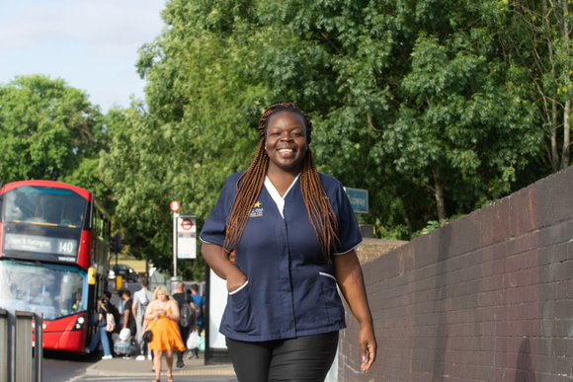
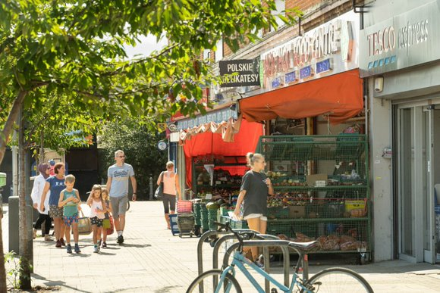
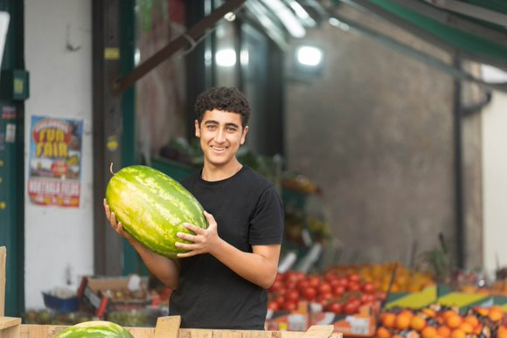
NORTHOLT
Foreword | Introduction | Acton | Ealing Town | Greenford | Hanwell | Northolt | Perivale | Southall | Appendices
Key Statistics | Population Overview | Health Profile | The Wider Determinants | Community Voice | Case Studies

Slide 28
Northolt: Key Statistics
Foreword | Introduction | Acton | Ealing Town | Greenford | Hanwell | Northolt | Perivale | Southall | Appendices
Key Statistics | Population Overview | Health Profile | The Wider Determinants | Community Voice | Case Studies

Slide 29
Northolt: Population Overview
Foreword | Introduction | Acton | Ealing Town | Greenford | Hanwell | Northolt | Perivale | Southall | Appendices
Key Statistics | Population Overview | Health Profile | The Wider Determinants | Community Voice | Case Studies
Population
There are 34,068 residents living in Northolt
Residents identifying as Asian/Asian British make up the largest proportion (28%) of the Northolt population
Northolt has the highest proportion of Black/Black British population (17.3%) and 3rd highest proportion of residents with Other ethnic heritage across the seven towns;
The largest religious identity is Christianity (41.2%), followed by Islam (21.8%)
Fourth highest proportion of households (60.4%) across the borough with English as their main language
After English, the top two languages spoken by children resident in Northolt and attending Ealing state-maintained schools are Arabic followed by Polish
Northolt has the second highest proportion (4.7%) of self-reported bad or very bad health across the borough
Deprivation
Northolt wards have an Index of Multiple Deprivation (IMD) Score (Mandeville 27.2; West End 33.3) that is higher than the borough average (22.7). The higher the IMD score the more deprived the area.
7 out of 18 LSOAs* in Northolt are in the most deprived 20%. Northolt has the highest proportion of the most deprived LSOAs across the seven towns (38.9%)
Northolt has the highest proportion (19.2%) of residents living in income-deprived households across the seven towns
*Lower Layer Super Output Area (LSOA) is a geographic area designed to improve the reporting of small area statistics in England and Wales. LSOAs have an average population of 1500 people or 650 households and there are 196 LSOAs in Ealing.

Slide 30
Northolt: Health Profile
Foreword | Introduction | Acton | Ealing Town | Greenford | Hanwell | Northolt | Perivale | Southall | Appendices
Key Statistics | Population Overview | Health Profile | The Wider Determinants | Community Voice | Case Studies
Life expectancy and deaths
The life expectancy of males in West End (80.9years) and Mandevile (81.1) is higher than the Ealing average (80.3). The life expectancy of women in West End (82.9 years) and Mandeville (84.1) is lower than the Ealing average (84.4)
The rate of preventable deaths is 5.4% higher than the England average
Third lowest rate of deaths involving Covid across the seven towns
Prevalence of long-term conditions in adults 18+*
Highest rate of obesity across the seven towns (1.3 times the Ealing average). The highest rates in the White British, Black African and Black Caribbean populations, all significantly higher than the Northolt average
Second highest rate of diabetes across the seven towns. The highest rates are in the Indian, Pakistani, Black Caribbean and Other Asian populations – all significantly higher than the Northolt average
Second highest rate of hypertension across the seven towns. The highest rates are in the White Irish, Black Caribbean, White British and Indian populations – all significantly higher than the Northolt average
Second highest rate of depression in the borough, 1.2 times the Ealing average. The highest rates are in the Mixed White & Black Caribbean, White British and White Irish populations - all significantly higher than the Northolt average. Note - there are low levels of recorded depression among South Asian communities. This may under-represent the true picture in some groups.
Other health indicators
Emergency hospital admissions for all causes, all ages, is approximately 21% higher than the England average
Hospital admissions for conditions attributable to alcohol is 15.5% higher than the England average (England: 100 and Ealing borough: 108.2)
The rates of overweight and obesity in Reception (26.5%) and Year 6 children (44.7%) are higher than the Ealing average (21.1% reception; 39.2% Year 6)
*data relates to number of people diagnosed.

Slide 31
Northolt: The Wider Determinants
Foreword | Introduction | Acton | Ealing Town | Greenford | Hanwell | Northolt | Perivale | Southall | Appendices
Key Statistics | Population Overview | Health Profile | The Wider Determinants | Community Voice | Case Studies
Income & Unemployment
Median household income estimates per year range across Northolt wards from £26,207 in West End to £28,164 in Mandevile (Ealing borough - £34,491; London - £36,427; UK - £32,400)
Highest proportion (9.6%) of the working age population claiming out of work benefit across the 7 towns
Highest rate of long-term unemployed in the working age population (5.1 per 1,000) across the borough
Housing
Third lowest number of households (11,755) across the seven towns; of these, 44.6% are owner occupied, 25.8% are privately rented, 27.7% are socially rented, 1.3% are in shared ownership, and 0.5% live rent free
Education
Highest proportion of children (35.3%) eligible for Free School Meals across the seven towns
Second lowest proportion of children achieving a good level of development at the end of reception, and the lowest proportion of pupils achieving expected standard in Reading Writing Maths at Key Stage 2 across the 7 towns
Crime
There were 2,792 total notifiable offences (TNO) in Northolt in 2022. The TNO rate is lower than the Ealing average
There were 98 domestic abuse offences (DAO) in Northolt in 2022. The DAO rate is higher than the Ealing average

Slide 32
Northolt: Community Voice
Foreword | Introduction | Acton | Ealing Town | Greenford | Hanwell | Northolt | Perivale | Southall | Appendices
Key Statistics | Population Overview | Health Profile | The Wider Determinants | Community Voice | Case Studies
What matters to Northolt residents for their health and wellbeing?
“Being part of a community, feeling appreciated, heard and represented.”
Local resident from the Active Northolt engagement event
“It is not safe for my teenage daughter to go to the park by herself during the day”
Resident from the Active Northolt engagement event
“Local people expressed an interest in getting involved in decisions about their local area […] locally-led decision making were unrepresentative of the community”
Visions for Northolt report
“Urban Edible Gardens, run by a Northolt resident, promoting healthier eating and urban growing in the more deprived areas of Northolt. There is a need to continue supporting initiatives like these in the future.”
Visions for Northolt report
“Elevate local areas to encourage people to use them more: add signage for short walks, add more public toilets, organise Park runs” Local resident at the Active Northolt engagement event

Slide 33
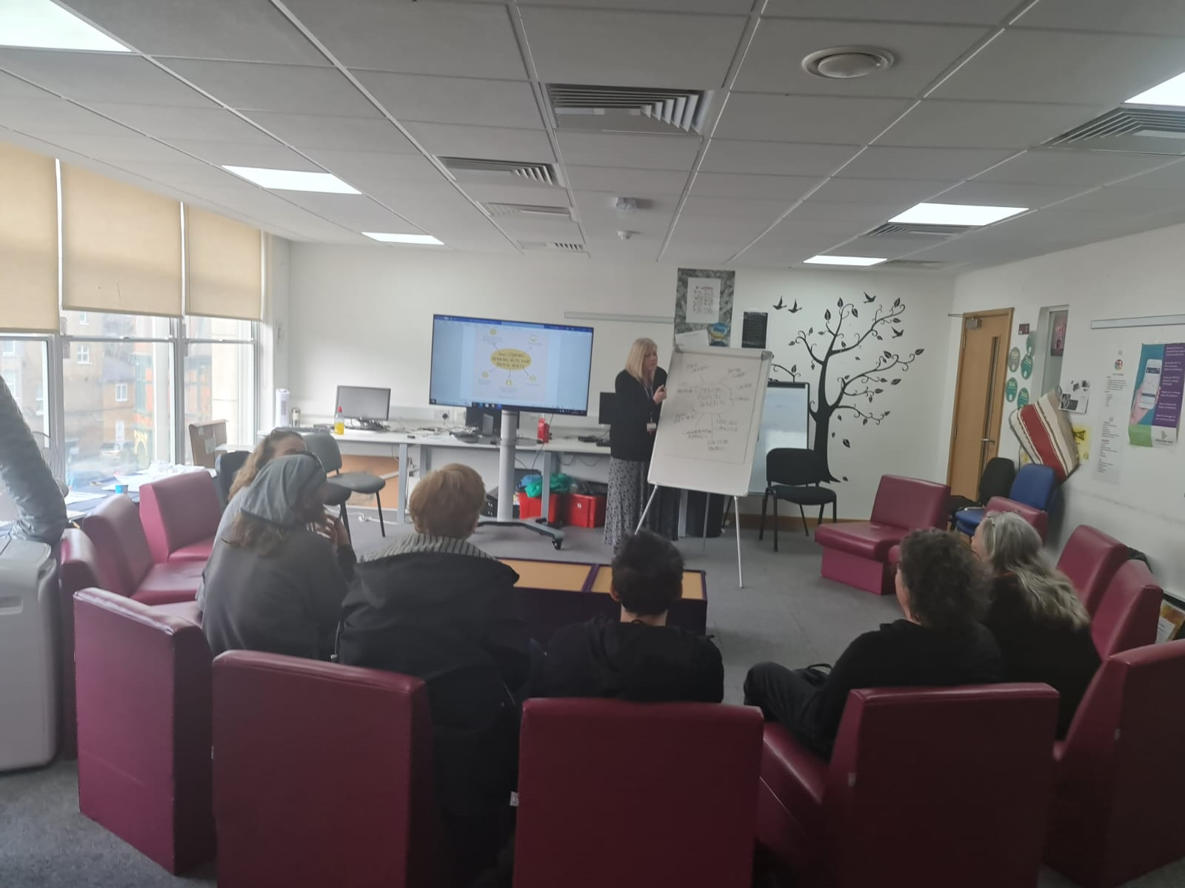
Northolt: Substance Misuse Service
Foreword | Introduction | Acton | Ealing Town | Greenford | Hanwell | Northolt | Perivale | Southall | Appendices
Key Statistics | Population Overview | Health Profile | The Wider Determinants | Community Voice | Case Studies
The drug and alcohol treatment system (RISE) are running a pilot during 2023 in Northolt, placing community engagement workers in primary care to deliver alcohol and drug interventions through sessions in GP surgeries, and other community settings including local gurdwaras. The worker will develop strong links with all relevant local services and community groups across the patch to support effective engagement and sustainment in structured treatment. They will be working as part of the neighbourhood network teams aimed at integrating services in multi-disciplinary teams.
They will be providing drug and alcohol treatment to residents with several healthcare needs and integrating the drug and alcohol work into a wider healthcare plan to help residents achieve more sustainable and effective outcomes.
RISE will reach a more hidden group of drinkers and drug users and engage them in treatment at an earlier stage and while they still have recovery capital in place such as friends, family and a job. This means there is the potential to achieve positive outcomes over a shorter treatment journey. The work will be part of several interventions aimed at reducing alcohol related hospital admissions in some of Ealing’s most affected areas.

Slide 34
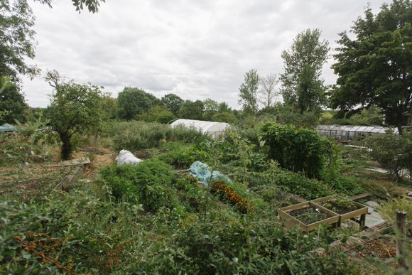
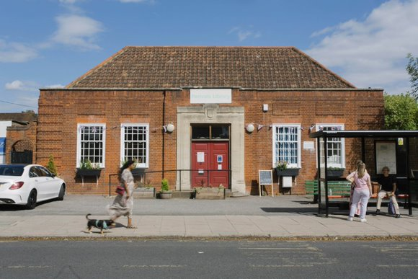
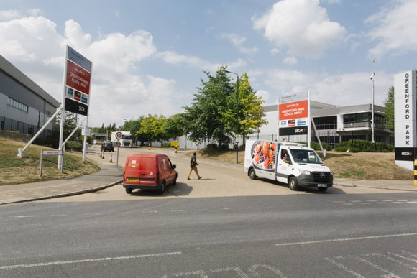
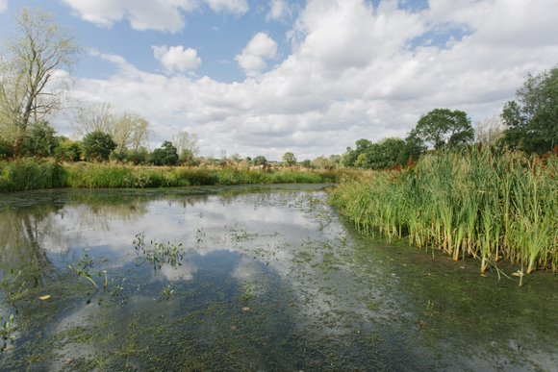
PERIVALE
Foreword | Introduction | Acton | Ealing Town | Greenford | Hanwell | Northolt | Perivale | Southall | Appendices
Key Statistics | Population Overview | Health Profile | The Wider Determinants | Community Voice

Slide 35
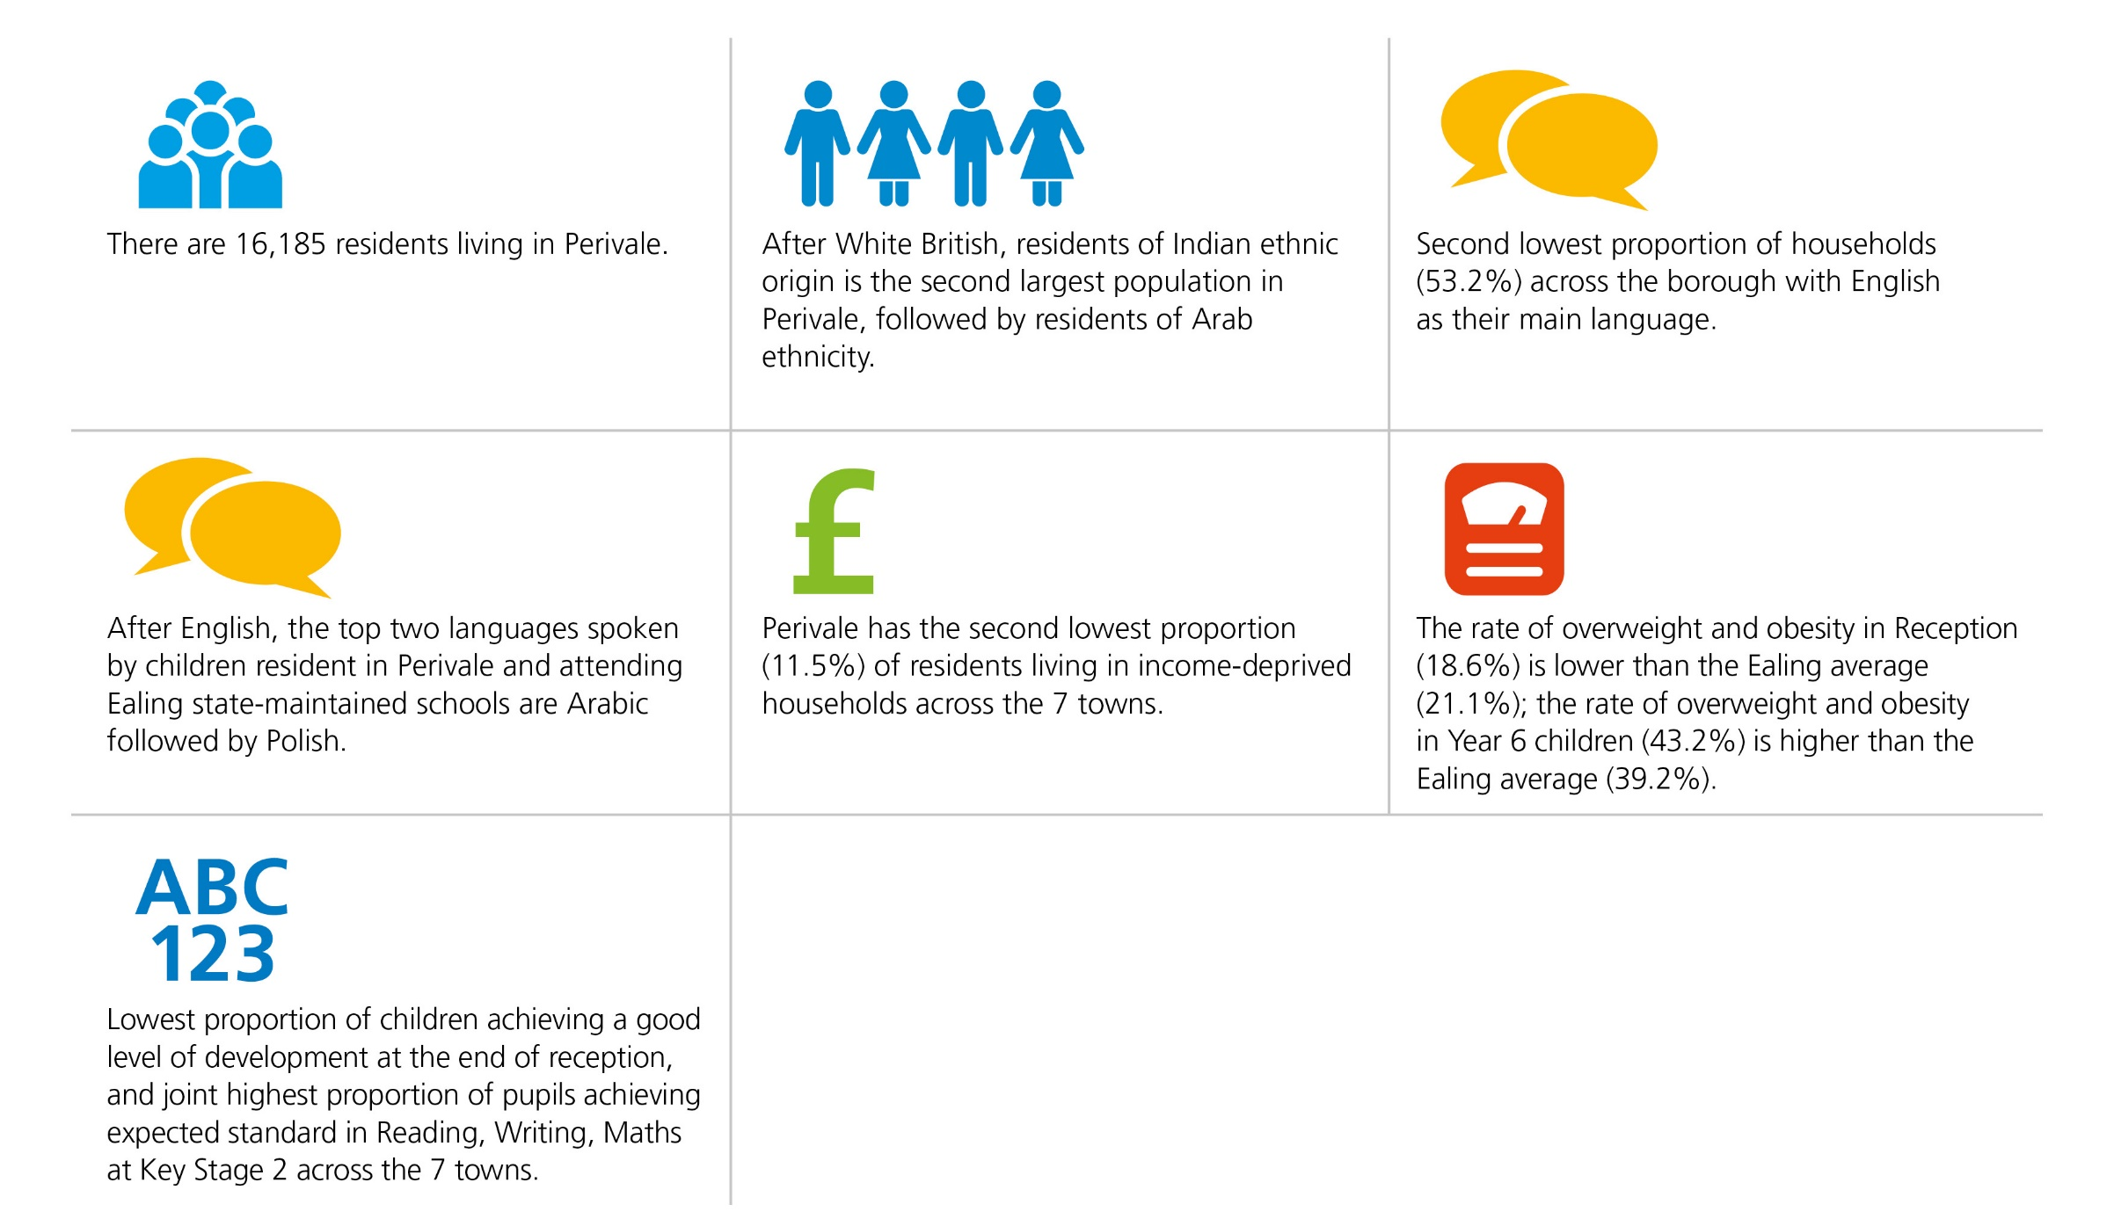
Perivale: Key Statistics
Foreword | Introduction | Acton | Ealing Town | Greenford | Hanwell | Northolt | Perivale | Southall | Appendices
Key Statistics | Population Overview | Health Profile | The Wider Determinants | Community Voice

Slide 36
Perivale: Population Overview
Foreword | Introduction | Acton | Ealing Town | Greenford | Hanwell | Northolt | Perivale | Southall | Appendices
Key Statistics | Population Overview | Health Profile | The Wider Determinants | Community Voice
Population
There are 16,185 residents living in Perivale
Residents identifying as Asian/Asian British make up the largest proportion (30.2%) of the Perivale population, followed by White Other (23.6%)
Perivale has the highest proportion of residents of Other ethnicity (16.8%) across the 7 towns
The largest religious identity is Christianity (41.4%), followed by Islam (23.4%)
Second lowest proportion of households (53.2%) across the borough with English as their main language
After English, the top two languages spoken by children resident in Perivale and attending Ealing state-maintained schools are Arabic followed by Polish
Perivale has the third lowest proportion (4.0%) of self-reported bad or very bad health across the borough
Deprivation
Perivale has an Index of Multiple Deprivation (IMD) Score of 17.7 which is lower than the borough average (22.7). The higher the IMD score the more deprived the area.
1 out of 9 LSOAs* is in the most deprived 20%. Perivale has the 2nd lowest proportion of the most deprived LSOAs across the seven towns (11.1%);
Perivale has the second lowest proportion (11.5%) of residents living in income-deprived households across the seven towns
*Lower Layer Super Output Area (LSOA) is a geographic area designed to improve the reporting of small area statistics in England and Wales. LSOAs have an average population of 1500 people or 650 households and there are 196 LSOAs in Ealing.

Slide 37
Perivale: Health Profile
Foreword | Introduction | Acton | Ealing Town | Greenford | Hanwell | Northolt | Perivale | Southall | Appendices
Key Statistics | Population Overview | Health Profile | The Wider Determinants | Community Voice
Life expectancy and deaths
The life expectancy of males (81.1 years) and females (86.1 years) in Perivale is higher than the Ealing average (80.3)
The rate of preventable deaths is 23.3% lower than the England average
Joint third highest rate of deaths involving Covid across the seven towns
Prevalence of long-term conditions in adults 18+*
Fourth highest rate of obesity across the seven towns. The highest rates are in the Mixed White & Black Caribbean, Black Caribbean, White Irish, Black African, White British, Bangladeshi and Other Black populations – all significantly higher than the Perivale average
Fourth highest rate of diabetes across the seven towns. The highest rates are in the Mixed White & Black Caribbean, and Bangladeshi populations, both significantly higher than the Perivale average
Fourth highest rate of hypertension across the seven towns. The highest rate is in the Black Caribbean population, nearly three times the Perivalee average
Second lowest rate of depression in the borough. The highest rates are in the White British and Other Mixed populations- all significantly higher than Perivale average. Note - there are low levels of recorded depression among South Asian communities. This may under-represent the true picture in some groups.
Other health indicators
Emergency hospital admissions for all causes, all ages, is approximately 4% higher than the England average
Hospital admissions for conditions attributable to alcohol is 15.9% higher than the England average (England: 100 and Ealing borough: 108.2)
The rate of overweight and obesity in Reception (18.6%) is lower than the Ealing average (21.1%); the rate of overweight and obesity in Year 6 children (43.2%) is higher than the Ealing average (39.2%)
*data relates to number of people diagnosed.

Slide 38
Perivale: The Wider Determinants
Foreword | Introduction | Acton | Ealing Town | Greenford | Hanwell | Northolt | Perivale | Southall | Appendices
Key Statistics | Population Overview | Health Profile | The Wider Determinants | Community Voice
Income & Unemployment
Median household income estimates per year in Perivale is £32,207 (Ealing borough - £34,491; London - £36,427; UK - £32,400)
Forth highest proportion (8.4%) of the working age population claiming out of work benefit across the 7 towns
Third highest rate of long-term unemployed in the working age population (3.5 per 1,000) across the borough
Housing
Lowest number of households (5,657) across the seven towns; of these, 54.8% are owner occupied, 35.5% are privately rented, 8.7% are socially rented, 0.9% are in shared ownership, and 0.1% live rent free
Education
Forth highest proportion of children (26.8%) eligible for Free School Meals across the seven towns
Lowest proportion of children achieving a good level of development at the end of reception, and joint highest proportion of pupils achieving expected standard in Reading Writing Maths at Key Stage 2 across the 7 towns
Crime
There were 1,491 total notifiable offences (TNO) in Perivale in 2022. The TNO rate is lower than the Ealing average
There were 40 domestic abuse offences (DAO) in Perivale in 2022. The DAO rate is higher than the Ealing average

Slide 39
Perivale: Community Voice
Foreword | Introduction | Acton | Ealing Town | Greenford | Hanwell | Northolt | Perivale | Southall | Appendices
Key Statistics | Population Overview | Health Profile | The Wider Determinants | Community Voice
What matters to Perivale residents for their health and wellbeing?
“Help with social isolation, especially for the over 60’s. We particularly miss Neighbourly Care - social activities, kind staff, excursions.”
Community conversations Mindfood Community Group
“More outdoor activities, and cheaper ways to exercise. Outdoors needs to feel safer - parks where drink and drugs are a problem are a put-off, especially if your older and on your own.”
Community conversations Mindfood Community Group
“We have lost family GP approach, where a holistic view is possible and helps to inform treatment or next steps - if this is no longer possible, people need to know how any changes are supposed to work so that they feel confident they won’t fall through the gaps.”
Community conversations Mindfood Community Group
“More help and advice on community matters and especially social care - a one stop shop, like a community centre. Friendly, supportive advice, activities, a social place to be. Why wait till life makes you so ill you have to see GP or social prescriber?”
Community conversations Mindfood Community Group

Slide 40
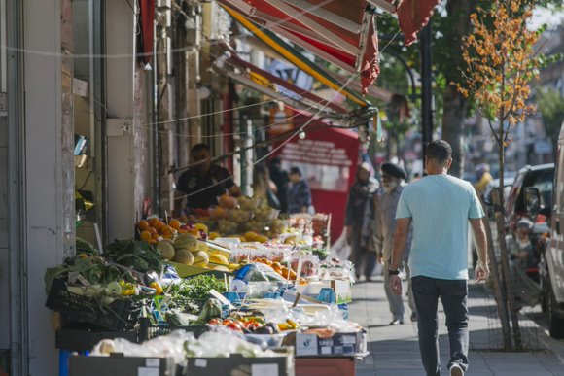
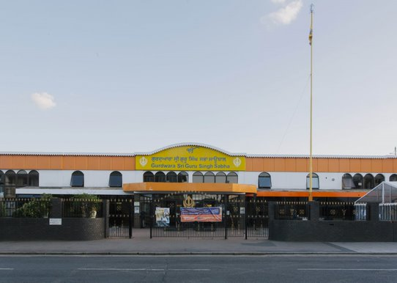
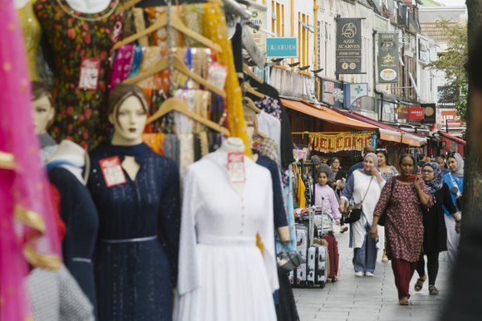
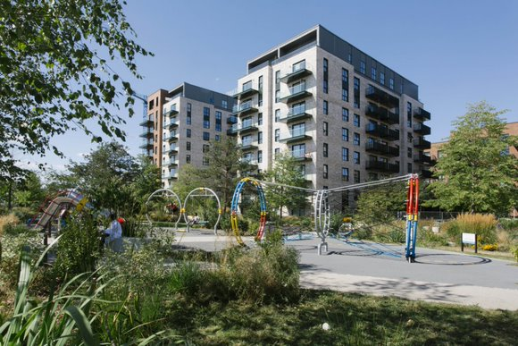
SOUTHALL
Foreword | Introduction | Acton | Ealing Town | Greenford | Hanwell | Northolt | Perivale | Southall | Appendices
Key Statistics | Population Overview | Health Profile | The Wider Determinants | Community Voice | Case Studies

Slide 41
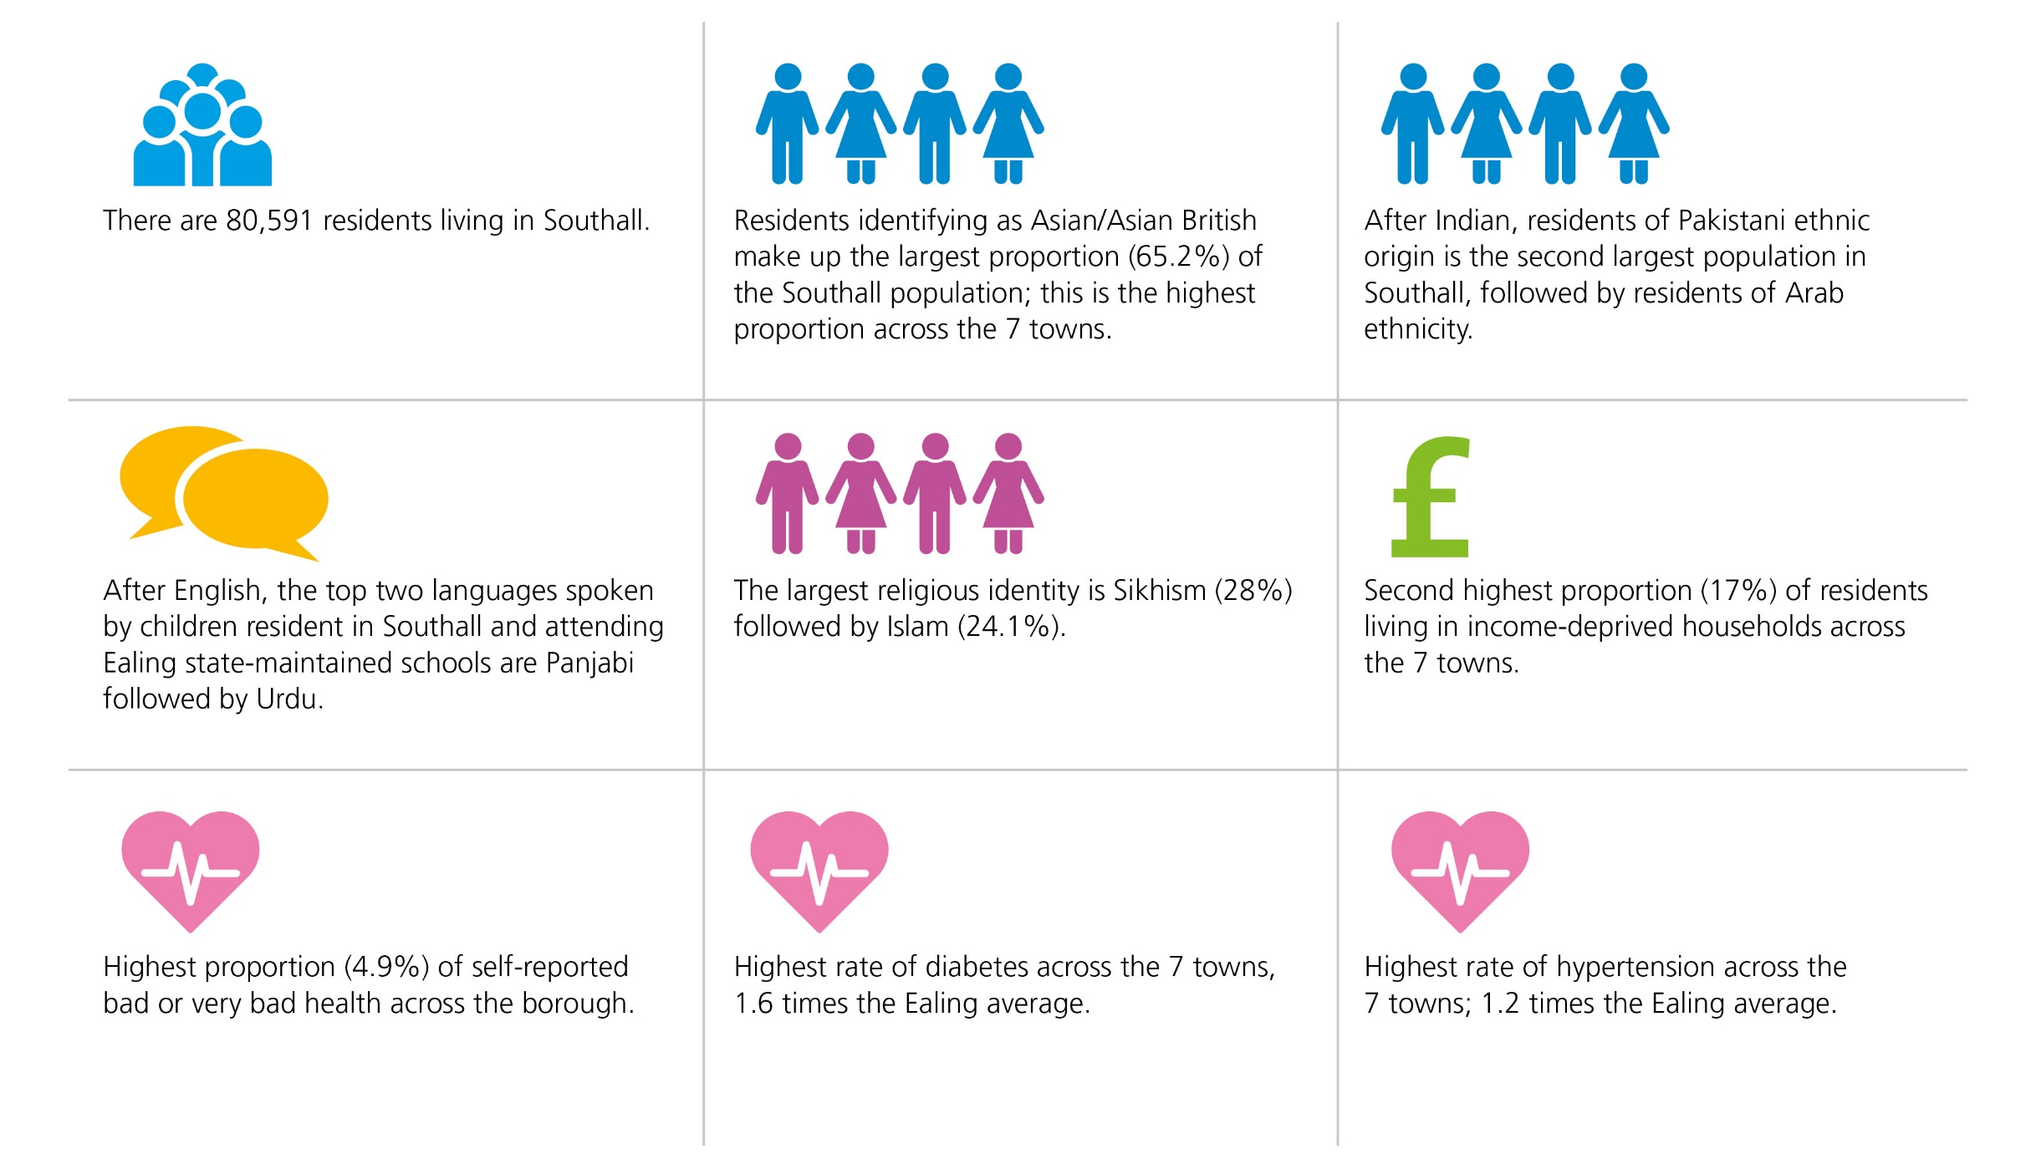
Southall: Key Statistics
Foreword | Introduction | Acton | Ealing Town | Greenford | Hanwell | Northolt | Perivale | Southall | Appendices
Key Statistics | Population Overview | Health Profile | The Wider Determinants | Community Voice | Case Studies

Slide 42
Southall: Population Overview
Foreword | Introduction | Acton | Ealing Town | Greenford | Hanwell | Northolt | Perivale | Southall | Appendices
Key Statistics | Population Overview | Health Profile | The Wider Determinants | Community Voice | Case Studies
Population
There are 80,591 residents living in Southall
Residents identifying as Asian/Asian British make up the largest proportion (65.2%) of the Southall population, followed by Other ethnicity (10.9%) and Black/Black British (10.2%)
Southall has the highest proportion of Asian/Asian British population across the seven towns and the lowest proportion of residents from both White British and White Other ethnic groups
The largest religious identity is Sikhism (28%) followed by Islam (24.1%)
Lowest proportion of households (43.3%) across the borough with English as their main language
After English, the top two languages spoken by children resident in Southall and attending Ealing state-maintained schools are Panjabi followed by Urdu
Highest proportion (4.9%) of self-reported bad or very bad health across the borough
Deprivation
Four Southall wards have an Index of Multiple Deprivation (IMD) Score (Southall Green 27.9; Dormers Wells 29.0; Southall Broadway 30.2; Norwood Green 32.9) that is higher than the borough average (22.7). The higher the IMD score the more deprived the area.
10 out of 39 LSOAs* are in the most deprived 20%. Southall has the 2nd highest proportion of the most deprived LSOAs within the seven towns (25.6%);
Second highest proportion (17%) of residents living in income-deprived households across the seven towns
*Lower Layer Super Output Area (LSOA) is a geographic area designed to improve the reporting of small area statistics in England and Wales. LSOAs have an average population of 1500 people or 650 households and there are 196 LSOAs in Ealing.

Slide 43
Southall: Health Profile
Foreword | Introduction | Acton | Ealing Town | Greenford | Hanwell | Northolt | Perivale | Southall | Appendices
Key Statistics | Population Overview | Health Profile | The Wider Determinants | Community Voice | Case Studies
Life expectancy and deaths
The life expectancy of men living in all Southall wards is lower than the Ealing average (80.3 years). The life expectancy of women living in Norwood Green, Lady Margaret, and Southall Green is lower than the Ealing average (84.4 years)
Women living in Dormers Wells live on average 4.2 years longer than women living in Norwood Green
The rate of preventable deaths is 13.6% higher than the England average
Highest rate of deaths involving Covid across the seven towns
Prevalence of long-term conditions in adults 18+*
Third highest rate of obesity across the seven towns. The highest rates are in the Black Caribbean, Mixed White & Black Caribbean, Pakistani, White British, Other Asian and Bangladeshi populations – all significantly higher than the Southall average
Highest rate of diabetes across the seven towns, 1.6 times the Ealing average. The Bangladeshi, Black Caribbean, Pakistani, Indian and White British populations have the highest rates, all significantly higher than the Southall average
Highest rate of hypertension across the seven towns; 1.2 times the Ealing average. The highest rates are in the Black Caribbean, White Irish, Mixed White & Black Caribbean, White British and Indian populations – all significantly higher than the Southall average
Lowest rate of depression in the borough. The highest rates are in the British, Irish and Mixed White & Black Caribbean populations, all significantly higher than the Southall average. Note - there are low levels of recorded depression among South Asian communities. This may under-represent the true picture in some groups.
Other health indicators
Emergency hospital admissions for all causes, all ages, is approximately 47% higher than the England average
Hospital admissions for conditions attributable to alcohol is approximately 36% higher than the England average (England: 100 and Ealing borough: 108.2)
The rates of overweight and obesity in Reception (22.6%) and Year 6 children (42.5%) are higher than the Ealing average (21.1% reception; 39.2% Year 6)
*data relates to number of people diagnosed.

Slide 44
Southall: The Wider Determinants
Foreword | Introduction | Acton | Ealing Town | Greenford | Hanwell | Northolt | Perivale | Southall | Appendices
Key Statistics | Population Overview | Health Profile | The Wider Determinants | Community Voice | Case Studies
Income & Unemployment
Median household income estimates per year range across Southall wards from £24,752 in Southall Broadway to £27,794 in Lady Margaret (Ealing borough - £34,491; London - £36,427; UK - £32,400)
Second highest proportion (9.65%) of the working age population claiming out of work benefit across the 7 towns
Third lowest rate of long-term unemployed in the working age population (2.9 per 1,000) across the borough
Housing
Third highest number of households (23,324) across the seven towns; of these, 45.1% are owner occupied, 33.5% are privately rented, 19% are socially rented, 2.2% are in shared ownership, and 0.3% live rent free
Education
Third highest proportion of children (28.4%) eligible for Free School Meals across the seven towns
Fourth highest proportion of children achieving a good level of development at the end of reception, and the second lowest proportion of pupils achieving expected standard in Reading Writing Maths at Key Stage 2 across the 7 towns
Crime
There were 8,012 total notifiable offences (TNO) in Southall in 2022. The TNO rate is higher than the Ealing average
There were 252 domestic abuse offences (DAO) in Southall in 2022. The DAO rate is higher than the Ealing average

Slide 45
Southall: Community Voice
Foreword | Introduction | Acton | Ealing Town | Greenford | Hanwell | Northolt | Perivale | Southall | Appendices
Key Statistics | Population Overview | Health Profile | The Wider Determinants | Community Voice | Case Studies
What matters to Southall residents for their health and wellbeing?
“Having (support from) someone from a similar culture or who understands the language spoken that people trust”
Let’s Go Southall engagement event
“Access to places where to buy to affordable healthy food, too much choice of fast food around.”
Let’s Go Southall engagement event
“Becoming part of a social movement programme like Let’s go Southall changed participants’ perspective on health and they became regularly active”
Let’s Go Southall engagement event
“Let’s Talk Sessions organised by a Let’s Go Southall lead for GP groups had a very positive impact on mental health of people participating”
Let’s Go Southall engagement event

Slide 46
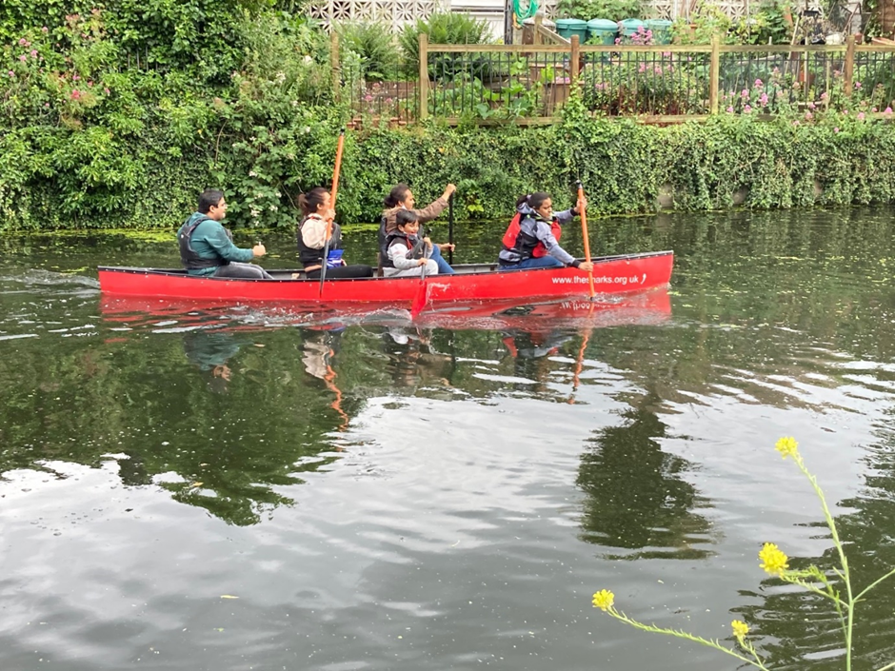
The Let’s Go Southall Active Communities Team
Foreword | Introduction | Acton | Ealing Town | Greenford | Hanwell | Northolt | Perivale | Southall | Appendices
Key Statistics | Population Overview | Health Profile | The Wider Determinants | Community Voice | Case Studies
Lets Go Southall (LGS) is a community led initiative established to enable people and the communities who live, work in Southall, or have local connections to promote social movement as a way of leading healthier lives and making Southall a better place to live. Funded by Sport England and driven by Ealing Council, we have brought together a cross range of local community stakeholders and partners, to help residents make lasting changes to their lifestyles, benefit from local support networks and develop how they can lead their people.
The programme is not about simply providing new sports facilities or services. It is a co-designed approach that empowers Southall residents – through providing skills, knowledge and opportunities to get involved. The campaigns we run are here for the whole community, individuals, families, teachers, leaders, all ages and all backgrounds.
It is grounded in the community as a movement working towards improving some of the inequalities that Southall faces. Establishing where inequalities impact people the most, we have been developing autonomy, capacity and resources needed for people to become happier and healthier. We are creating a whole systems approach which considers the way in which we can all benefit and embed community led change.
We deliver a wide range of free activities and interventions, aimed at improving wellbeing at an individual and community level. Coming together to take part in fun, free activities make people feel a sense of belonging and with our local Active Communities Team made up of local residents, the large amount of people who are not active are more likely to get involved.

Slide 47
Appendix 1 – Data reference list
Foreword | Introduction | Acton | Ealing Town | Greenford | Hanwell | Northolt | Perivale | Southall | Appendices
Appendix 1 | Appendix 2
Population
National Census, 2021
GFR: ONS (5-years pooled data, 2016-20)
The top two community languages in Ealing schools: School Census Jan 2023 (Ealing Schools, Research and Statistics Team)
Income & Unemployment
Income: (CACI, Equalised Pay Check Directory 2022)
Unemployment, 2021/22: NOMIS Labour Market Statistics (OHID, Local Health - Small Area Public Health Data, 2022)
Housing
National Census, 2021
Deprivation
IMD 2019, Ministry of Housing, Communities & Local Government (OHID, Local Health - Small Area Public Health Data, 2022)
Life expectancy and causes of death
Life expectancy, 5-years pooled data, 2016-20: OHID analysis of ONS death registration data and mid-year population estimates (OHID, Local Health - Small Area Public Health Data, 2022)
Deaths from all causes, all ages/under 75, 5-years pooled data, 2016-20: OHID, based on ONS data (OHID, Local Health - Small Area Public Health Data, 2022)
Deaths involving COVID, 1st Jan 2020 to 31st Jan 2023: NWL ICB, Ealing residents registered with a NWL GP practice as of 9th March 2023, diagnosed/coded with the LTC in SystmOne
Other health indicators
Hospital admissions, 5-years pooled data, 2016/17-20/21: HES (OHID, Local Health - Small Area Public Health Data, 2022)
Cancers incidence, 5-years pooled data, 2015-19: English cancer registration data from the NHS Digital Cancer Analysis System (OHID, Local Health - Small Area Public Health Data, 2022)
Child obesity, 3-years pooled data, 2019/20 – 21/22: OHID, using National Child Measurement Programme, NHS Digital (OHID, Local Health - Small Area Public Health Data, 2022)
Prevalence of long-term conditions and ethnicity
Obesity, Diabetes, Hypertension and Depression (all 18+): NWL ICB, Ealing residents registered with a NWL GP practice as of 6th Jan 2023, diagnosed/coded with the LTC in SystmOne
Education
FSM: Autumn School Census 2022 (Ealing Schools, Research and Statistics Team)
GLD & KS2: Summer assessments 2022 (Ealing Schools, Research and Statistics Team)
Crime
Metropolitan Police Service (MPS), 2022 (Ealing Strategic Intelligence and Corporate Performance Team)

Slide 48
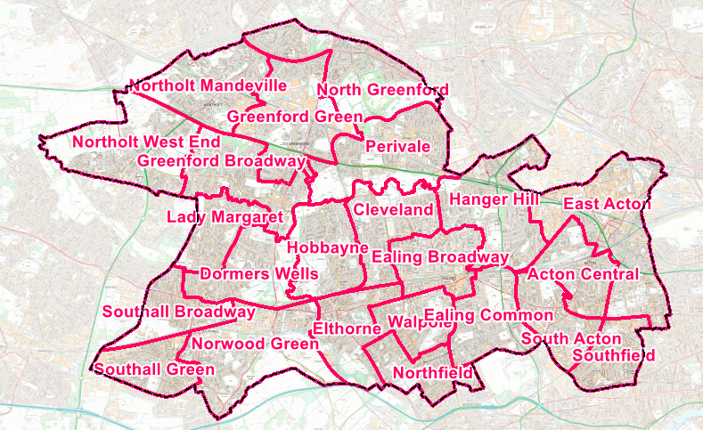
Appendix 2 – Map of Ealing Wards (pre-2022)
Foreword | Introduction | Acton | Ealing Town | Greenford | Hanwell | Northolt | Perivale | Southall | Appendices
Appendix 1 | Appendix 2
Please note that the following maps are based on Ward names and boundaries that were valid up until 5th May 2022, and have since changed.
The published data included in this report is only available using the old Wards, so these maps are relevant for the data provided.
Once the datasets are updated, the Town maps will be updated with the new Ward names and boundaries.

